Slide 1
JUMPING JIVE WP7 – The Future of VLBI
Tiziana Venturi
INAF, Istituto di Radioastronomia
Co-leaders: M. Lindqvist (OSO), Z. Paragi (JIVE)

Slide 2
Goals of the WP
Revision of the scientific roadmap for VLBI
Because of the progress in the field of astrophysics and the changes in the radio astronomy landscape it is timely to revisit the EVN science case. In consultation with the user community and global partners we will define the most important science areas for future VLBI array.
main deliverable

Slide 3
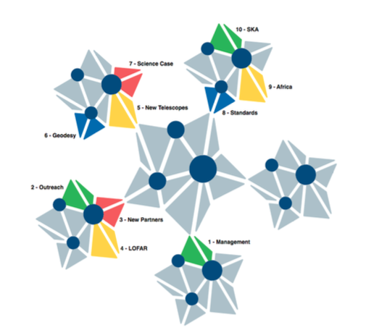
Relations to other WPs in the project Capacity of doing science
WP10 – VLBI with the SKA
WP9 – Capacity for VLBI in Africa
WP6 – Geodetic capabilities

Slide 4
Workplan
WP7
Consultation with CBD
WP6
Team of selected experts
Users community
WP9
WP10
Final document

Slide 5
Implementation plan
Core team of max 10 experts identifies key science areas and experts for the various sections/chapters
Core team and experts meet in a 1-2 day brainstorming meeting:
to identify key science areas and technological developments;
to discuss how to involve the community at large
The write up of the document starts
R. Beswick, T. Bogdanovic, W. Brisken, P.Charlot, M. Lindqvist, A. Lobanov, Z. Paragi, A. Szomoru, T. Venturi

Slide 6
Meetings in preparation of the document
VLBI session at the meeting: eMERLIN and EVN in the SKA era (Jodrell Bank, 11-12 September 2017)
1.5 days F2F meeting (Zaandam, 28 February – 1 March 2018)
Special Session SS11 @ EWASS 2018: Exploring the Universe: a European vision for the future of VLBI (Liverpool, 4 April 2018)
Open dicussion on the EVN Vision Document at the 14th EVN Symposium in Granada (8-11 October 2018)
Meeting of the WP leaders to assemble the first version of the document (Bologna, 21-23 January 2019
EVN Closed Session at the SKA-VLBI Key Science Projects and Operations Workshop (SKAO, 14-17 October 2019)
F2F Meeting of the WP leaders to review the document and prepare an advanced version (Bologna, 28-30 January 2020)
Document completed in June 2020 and published on arXiv in July 2020
https://arxiv.org/abs/2007.02347

Slide 7
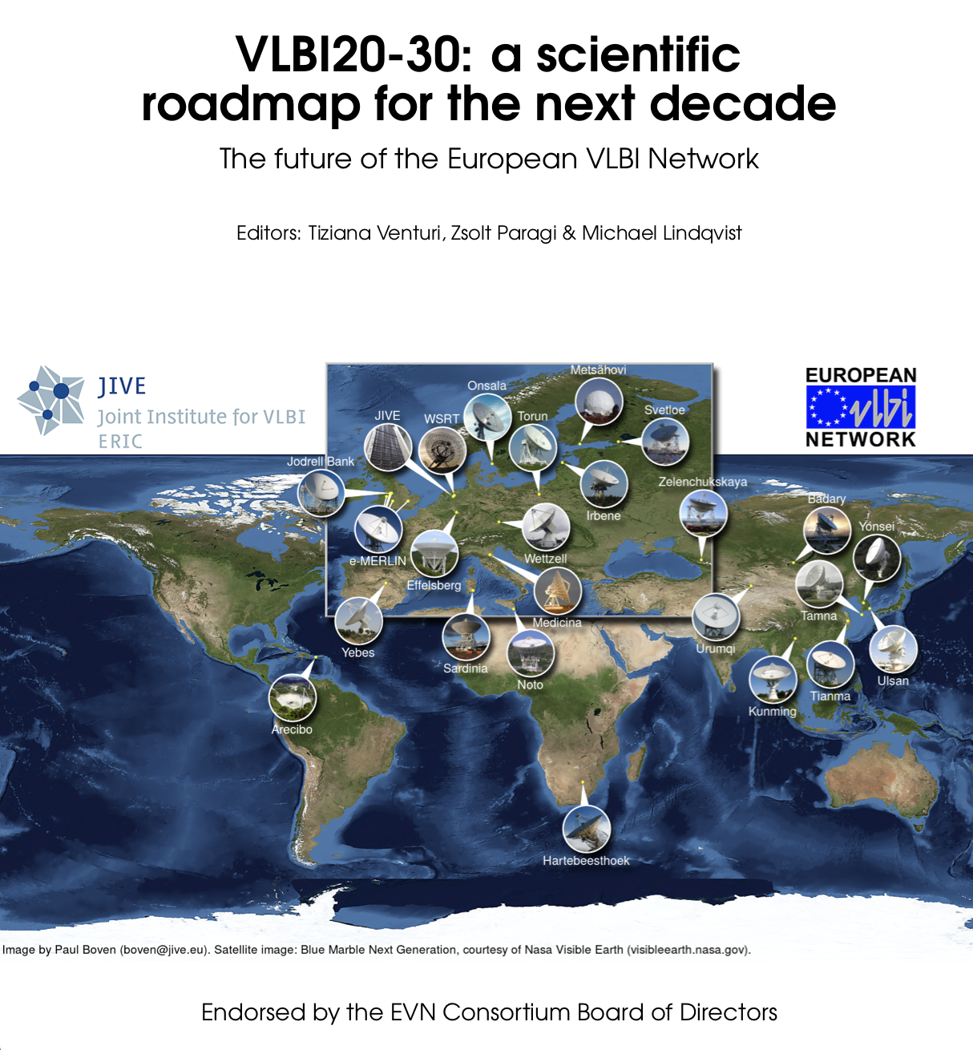
The deliverable
Great community effort
https://arxiv.org/abs/2007.02347
Main topics:
Cosmology
Galaxy formation and evolution
Innermost regions of AGN
Explosive phenomena, transients
Stars and stellar masers in the Milky Way
Earth and Space
Moreover:
overview of the current facilities;
synergy with other ground and space observatories;
suggestions for a technological roadmap
An amazing broadening of the science where
VLBI plays a unique role compared to 15 years ago

Slide 8
General considerations on the achievements
The workplan turned out to be very successful. It has been carefully followed throughout the project, which allowed a timely submission of all the deliverables, including the main one
The document has been finalized with a mixed approach: top-down at the beginning (WP leaders and core team), but with a lot of consultation of the community
Very good response and interest in joining the effort – about 70 people were involved (mainly from partner countries, but also from the US, East Asia South Africa and Australia), with ~20% women

Slide 9
General considerations on the achievements
Strong synergy with the other WPs in the project, both in terms of contribution of other WP leaders and of coordination of actions
Very good communication and information flow among the WPs, with positive impact on the activity
Shared effort among the WP leaders (great team) and the chapter coordinators and contributors. All partners have taken part in the activity

Slide 10
General considerations on the achievements
The document has been recognised as one of the current scientific roadmaps, and it is a reference for several independent communities
The recommendations for the technological development have been acknowledged by the EVN Board of Directors and are a reference for upgrades and technological and operational developments in the EVN
The document has been presented at several international meetings and workshops, with the goal to increase the awareness of the scientific unique potentials of VLBI, as well as of the various stakeholders and officers
It is the basis for the inclusion of VLBI operations at other arrays, such as uGMRT and MeerKAT

Slide 11
In Summary
Very successful activity which has strengthened the ties of the VLBI community
The brainstorming during the various meetings has been extremely fruitful at several levels, not just scientific
Young bright researchers have taken part in the process, providing an invaluable injection of ideas and enthusiasm
Unfortunately the pandemic situation has affected the presentation of the document at meetings in person, but the community has been successfully reached anyways.
It has been a great and rewarding experience

Slide 12
THANK YOU FOR YOUR ATTENTION

