Slide 1
JUMPING JIVE WP5: Integrating New Elements
Pablo de Vicente, Bob Campbell
07/10/2021
JUMPING JIVE Final Review
1

Slide 2
WP5 tasks
Task 1: Enhancements at EVN and affiliated telescopes.
Task 2: Supporting new telescopes and creating an inventory of potential new facilities that could join the EVN in a short-term period.
Task 3: Improving the station feedback from the pipeline and archive.
07/10/2021
JUMPING JIVE Final Review
2

Slide 3
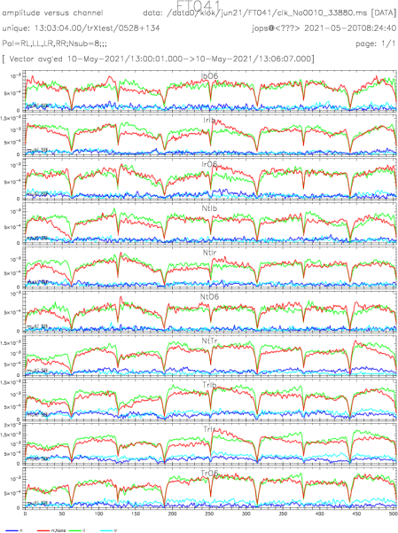
Task 1 Overview
1. Incorporate new stations operationally
e-MERLIN; 4 bands at Kunming
Hardware developments
New receivers: Q-band (Ys, T6, Ef, KVN); X (Tr); P (Jb)
Digital back-end / firmware testing
e-VLBI:
3 Russian stations, Sardinia, KVN, e-MERLIN
100 Gbps network capacity into Dwingeloo
Continuous-calibration systems
FlexBuff / e-shipping (all but 4 stations)
07/10/2021
JUMPING JIVE Final Review
3

Slide 4
Task 1 Impact
1. JUMPING JIVE Support Scientist
Coordinate/review tests // liaise with stations
Users benefit
Array Composition
More short baselines, east Asian telescopes
Improving frequency coverage
e-VLBI: array close to matching the disk-based one
Network capabilities
4 Gbps for λ≤6cm
Better band-pass shapes, improved set-up reliability
Continuous-cal:
improved amplitude calibration, ease of scheduling
07/10/2021
JUMPING JIVE Final Review
4

Slide 5
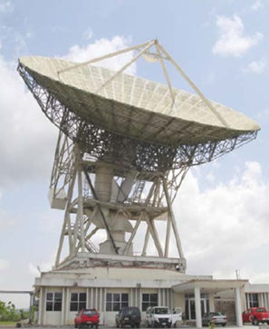
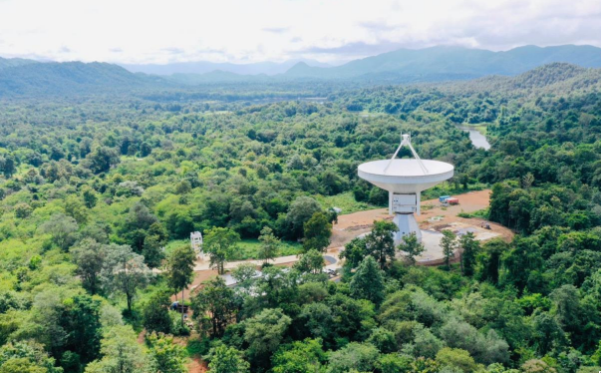
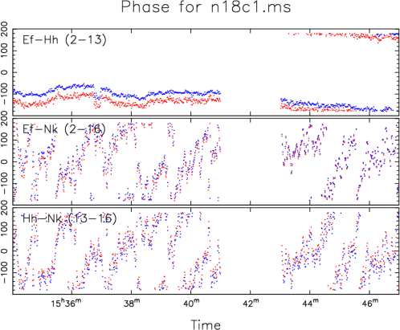
Task 2 Overview
New stations that could join/participate with the EVN
New construction: e.g., TNRT 40m (TH), MeerKAT (ZA)
Geodetic antennas: e.g., Santa Maria RAEGE (PT)
Repurposed communication antennas
Kuntunse (GH), Zolochiv (UA) [have joined NMEs]
Hellenic (GR)
Other: uGMRT (IN), ROT 54/2.6m (AM)
07/10/2021
JUMPING JIVE Final Review
5

Slide 6
Task 2 Impact
1. Knowledge Exchange
EVN → new sites
Technical Advisory Committees, Site Visits
International Conferences (e.g., uGMRT, Zolochiv)
Training Visits (e.g., Kuntunse — along with WP9)
New sites → EVN
Station personnel participating in EVN TOG & CBD meetings, as well as IVS TOW workshops
Path for EVN growth / globalization of JIVE (e.g., WP3)
EAVN, towards LBA
AVN, road to SKA-MID (e.g., WP10)
07/10/2021
JUMPING JIVE Final Review
6

Slide 7
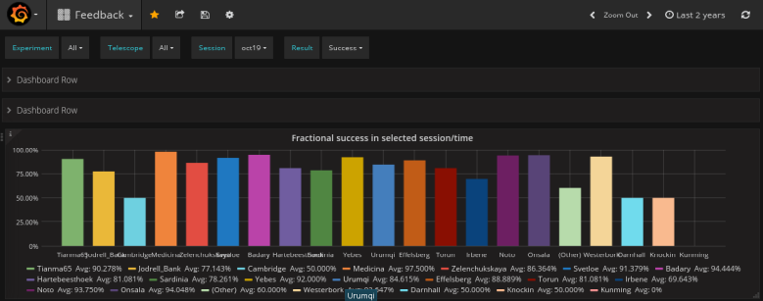
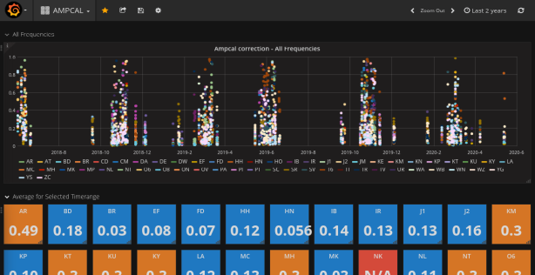
Task 3 Overview
1. Databases designed to drive station-based presentation
Automatic loading: pre- and post-correlation sources
Front-end web interface: grafana
Customizable station querying, dashboards
mattermost chosen as intra-EVN communication channel
Server installed at JIVE for EVN-wide access
07/10/2021
JUMPING JIVE Final Review
7

Slide 8
Task 3 Impact
1. Station uptake
9 station-specific dashboards, plus one for the VLBA
On-going discussions about how to improve
Computation of statistics
What to collect/present in light of equipment evolution
Implications of a centralized monitoring system (WP8)
07/10/2021
JUMPING JIVE Final Review
8

Slide 9
Use of Resources // 1-sentence take-away
1. JUMPING JIVE Support Scientist
80% WP5; 2 distinct people over the 4+ years
Handle tests; confer with stations; TOG presentations
Designed the new capabilities in Task 3
Travel support
Vital aspect — fosters community building
COVID-19 restrictions curtailed personal/hands-on visits
Groundwork laid for JIVE playing a principal role in the Global VLBI Alliance, an IAU working group.
07/10/2021
JUMPING JIVE Final Review
9

