Slide 1
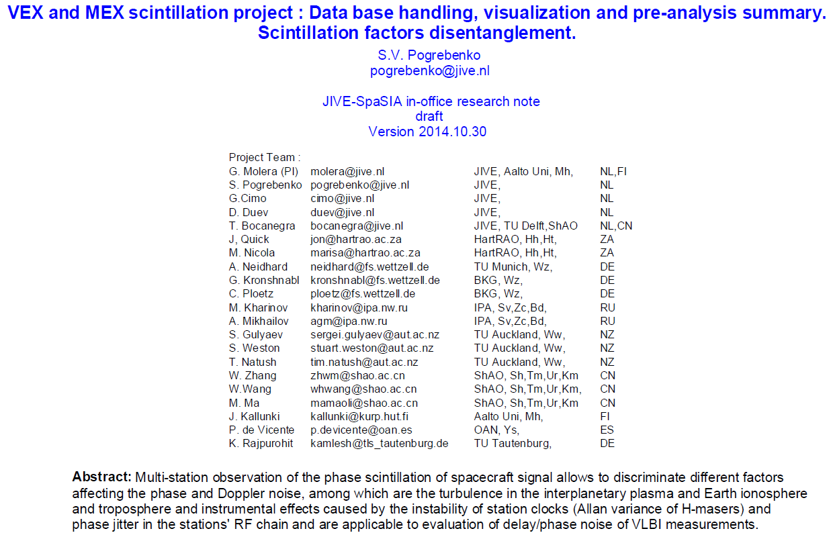
PaseCal travelling to the higher skies and back
Publications: Molera et al, A&A, 2014
Molera et al, PSS, submitted 2014

Slide 2
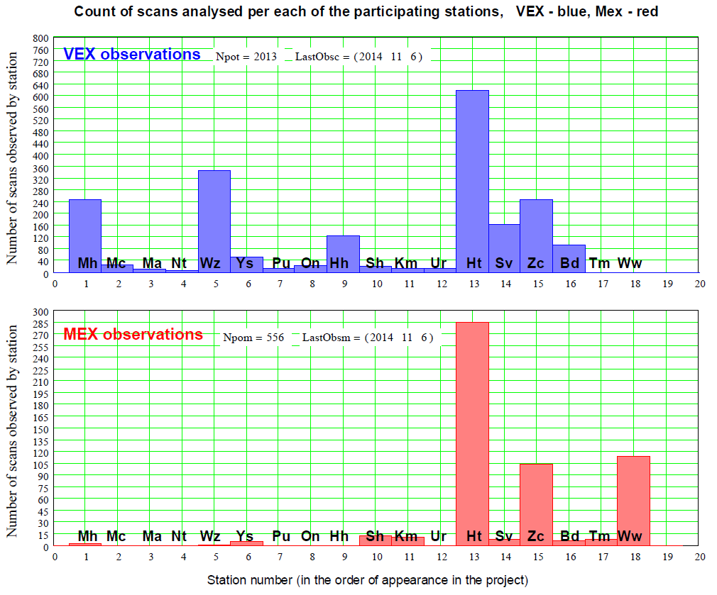

Slide 3
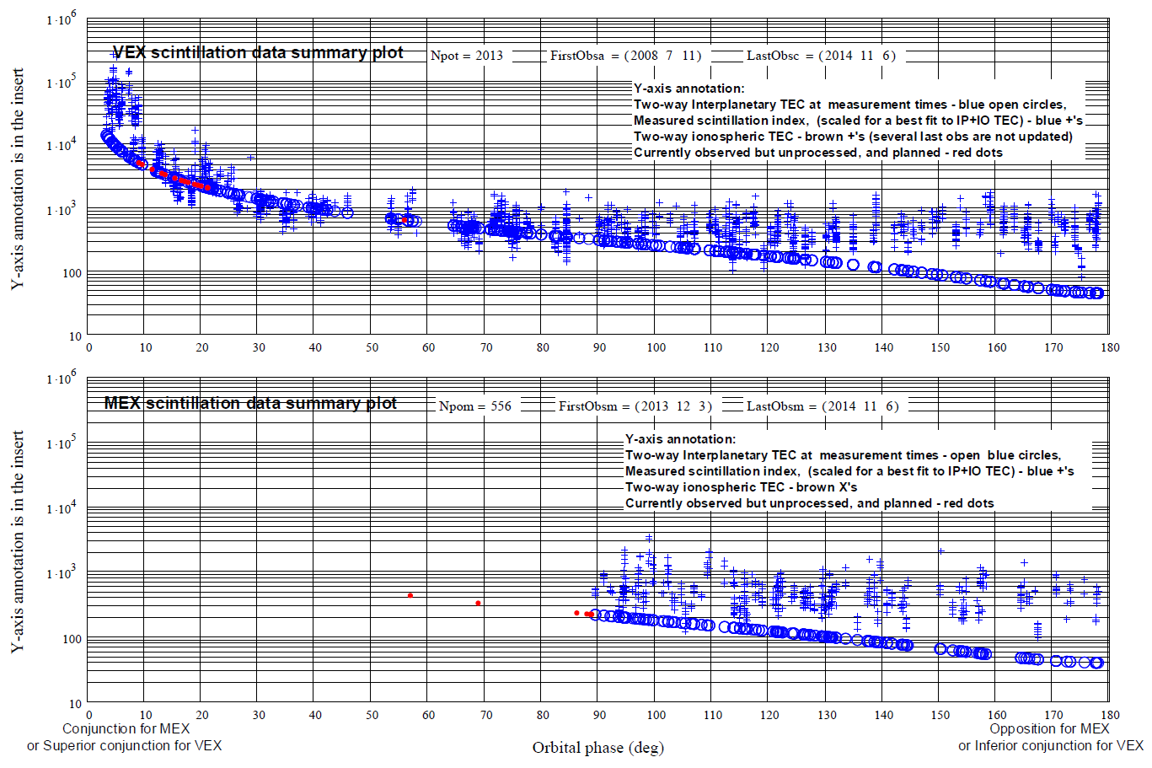
2 . Summary plot os scintillation measurements

Slide 4
2 . Spacecraft observations: Scintillation Study, Analysis

Slide 5
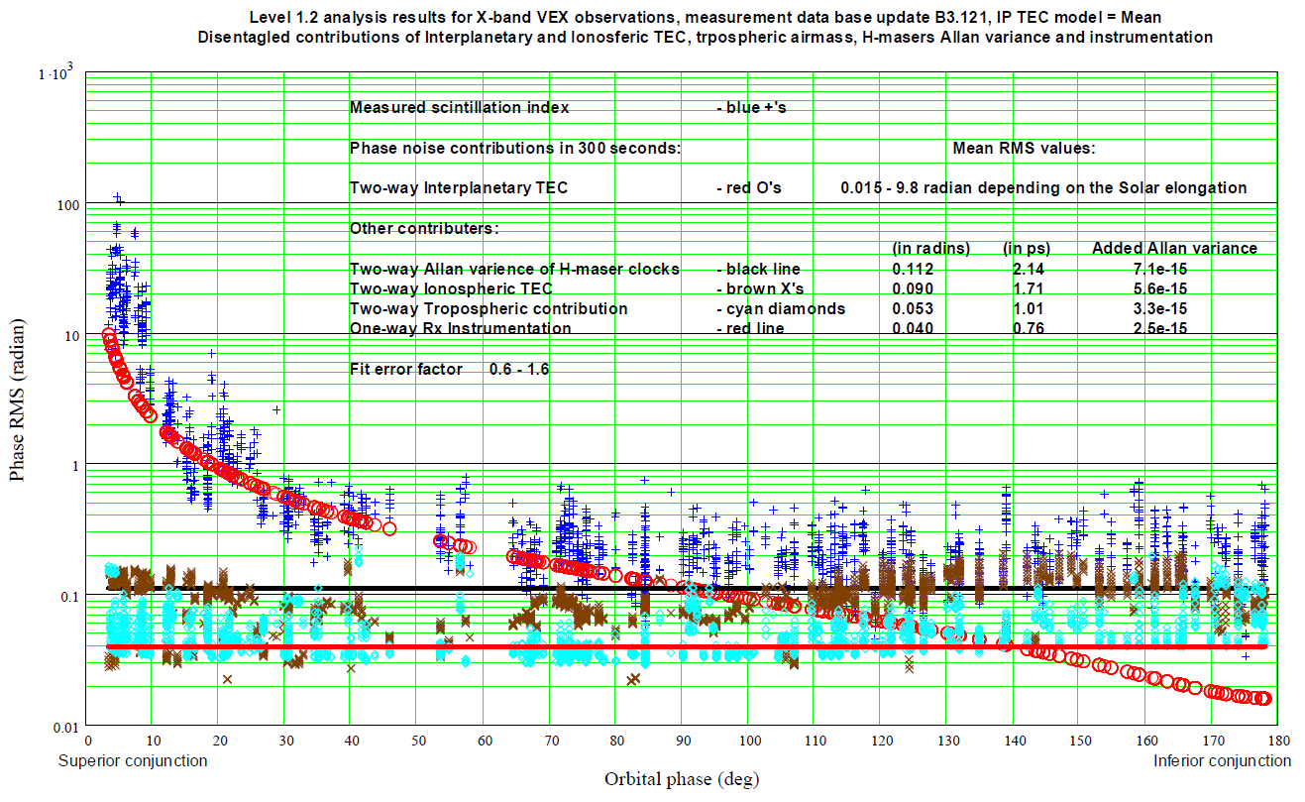
Spacecraft observations: Scintillation Study, Analysis
Disentanglement of Interplanetary plasma, ionospheric and tropospheric scintillations
and instrumental effects

Slide 6
Conclusion:
Contribution of Interplanetary and Ionospheric plasma,
Troposphere, instrumental effects and H-masers instability
are disentangled.
Clock stability improvement can reduce the VLBI phase noise
by a factor of 1.5 - 2

