Slide 1
Welcome to the CASA-VLBI workshop!
#casavlbi2020

Slide 2
Welcome by the director

Slide 3
Events this week
Lectures: recording and live stream
Data processing in Zoom break-out rooms
Plenary question sessions
Social events:
Mi casa es tu casa: joint walk around the world
Pub quiz
Conference picture

Slide 4
Asking questions
During a webinar style session:
Zoom Q&A
Zoom chat (Panelists & Attendees)
Mattermost channel
During a plenary style session:
Raise hand button
Zoom chat
Unmute *ONLY* when addressed by the chair

Slide 5
Break-out sessions
12 rooms of 15-20 participants each
always the same people
make your own Mattermost channel
tutors go in and out of the rooms
direct questions via tags in Mattermost

Slide 6
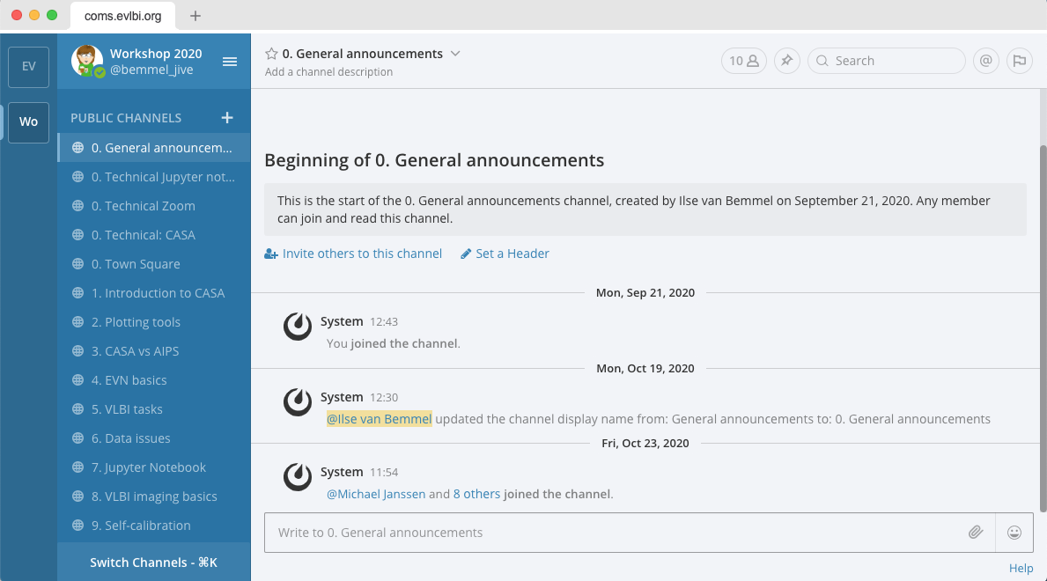
The software
CASA 5.6 or CASA 5.7, python 2 based
Zoom 5.3 or higher: webinar and plenary style sessions
Mattermost: browser or desktop client

Slide 7
Finally...
All information is on the workshop wiki page
jive.eu Wiki button casa
Consider other people’s privacy on social media
Observe the Code of Conduct

Slide 8
Thanks to our sponsors
This event has received funding from the European Union’s Horizon 2020 research and innovation programme
under grant agreements 730562 (RadioNet) and 7308844 (JUMPING JIVE)

