Slide 1
JUMPING JIVE WP3: New Partnerships
Leonid Gurvits
Joint Institute for VLBI ERIC
JUMPING JIVE final meeting
12 October 2021

Slide 2
JIMPING JIVE WP3 scope
Main focus – enhancement of JIV-ERIC within EVN
Key words: globalisation [of VLBI], new partnerships & SKA [@VLBI]
Incentives for joining the [EVN] VLBI “club” & JIV-ERIC
Involvement in cutting-edge research
Direct access to intellectual property of the global science endeavor
Joint exploitation of the global VLBI potential for national sci priorities
Plus practical benefits of being ERIC member (e.g., VAT exemption)
Joint exploitation of the educational and PO potential of VLBI
Implementation of WP3 in three tiers:
Tier 1 – experienced and active VLBI centres – on the way to JIV-ERIC
Tier 2 – “EVN-unaffiliated” user groups and facilities;
Tier 3 – ”seed” VLBI activities with new groups (in Europe and beyond)

Slide 3
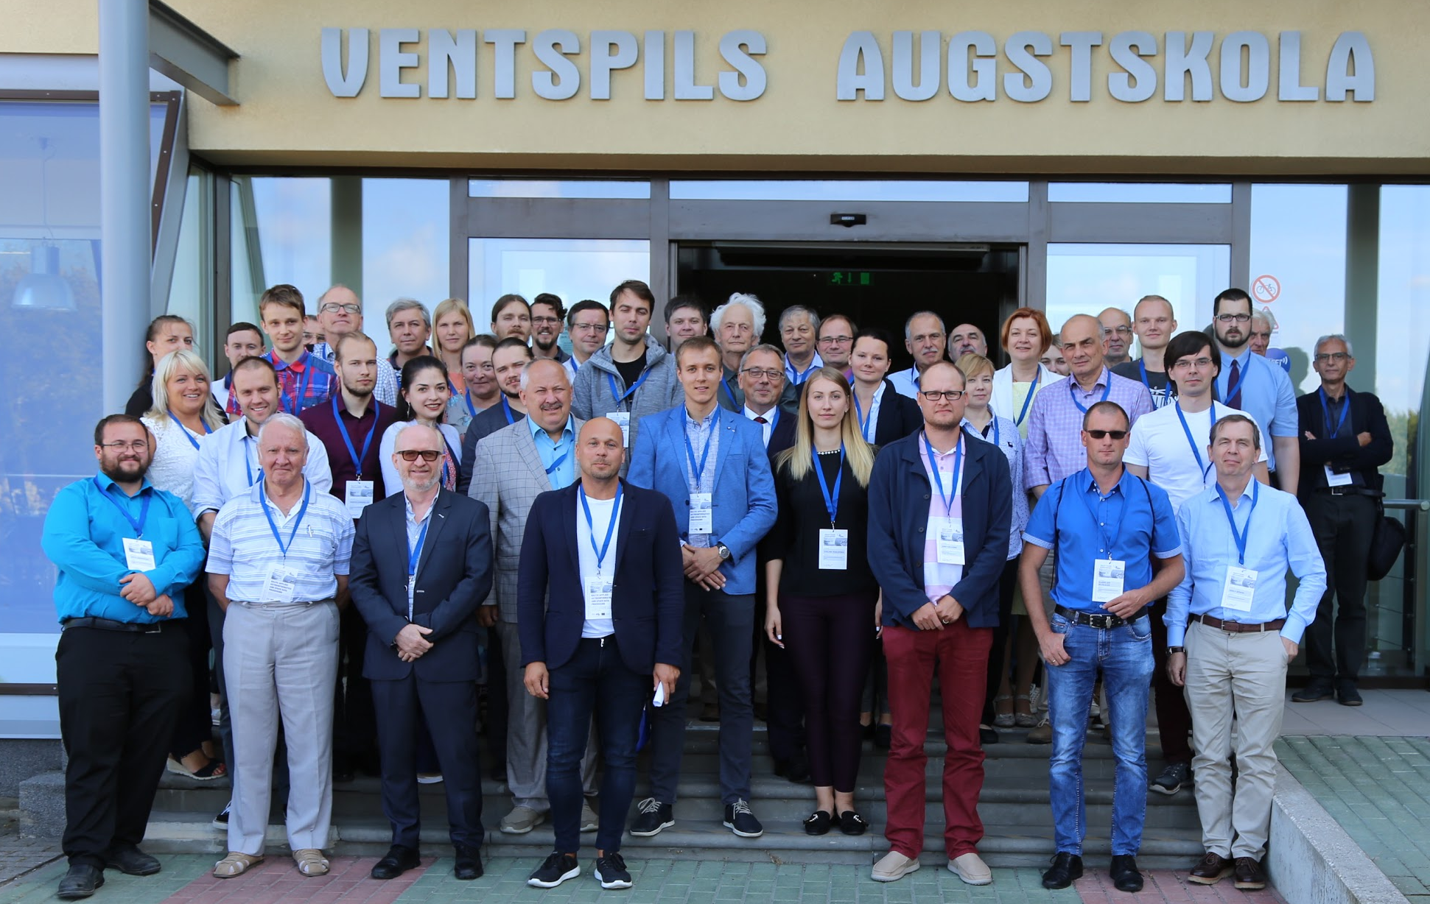
WP3 Tier 1 “renovation”
NAOC CAS (China), JIVE associate since 2005
Participation in JIV-ERIC on the basis of 2-3-year-long MoA’s
The latest MoA for 2019-2021 signed in 2019
New items of collaboration – “exponential” developments in China
Latvia – VUC-VIRAC, JIV-ERIC member
New Minister, new management at the Ministry since 2019
Several changes of administration at VIRAC over the past 6 years
Need for continuing persistent “coaching”
Collaboration with EVN and JIVE – a major “ingredient” for involvement in JIV-ERIC
Participation in BAASP-2019,-21
VIRAC Advisory Board (Gurvits)
Need for a strong case in the
national science agenda
Educational component needs
further support

Slide 4
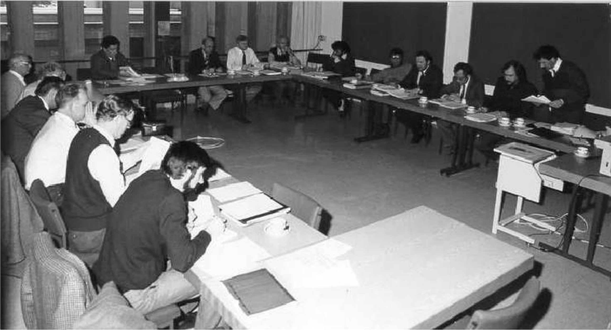
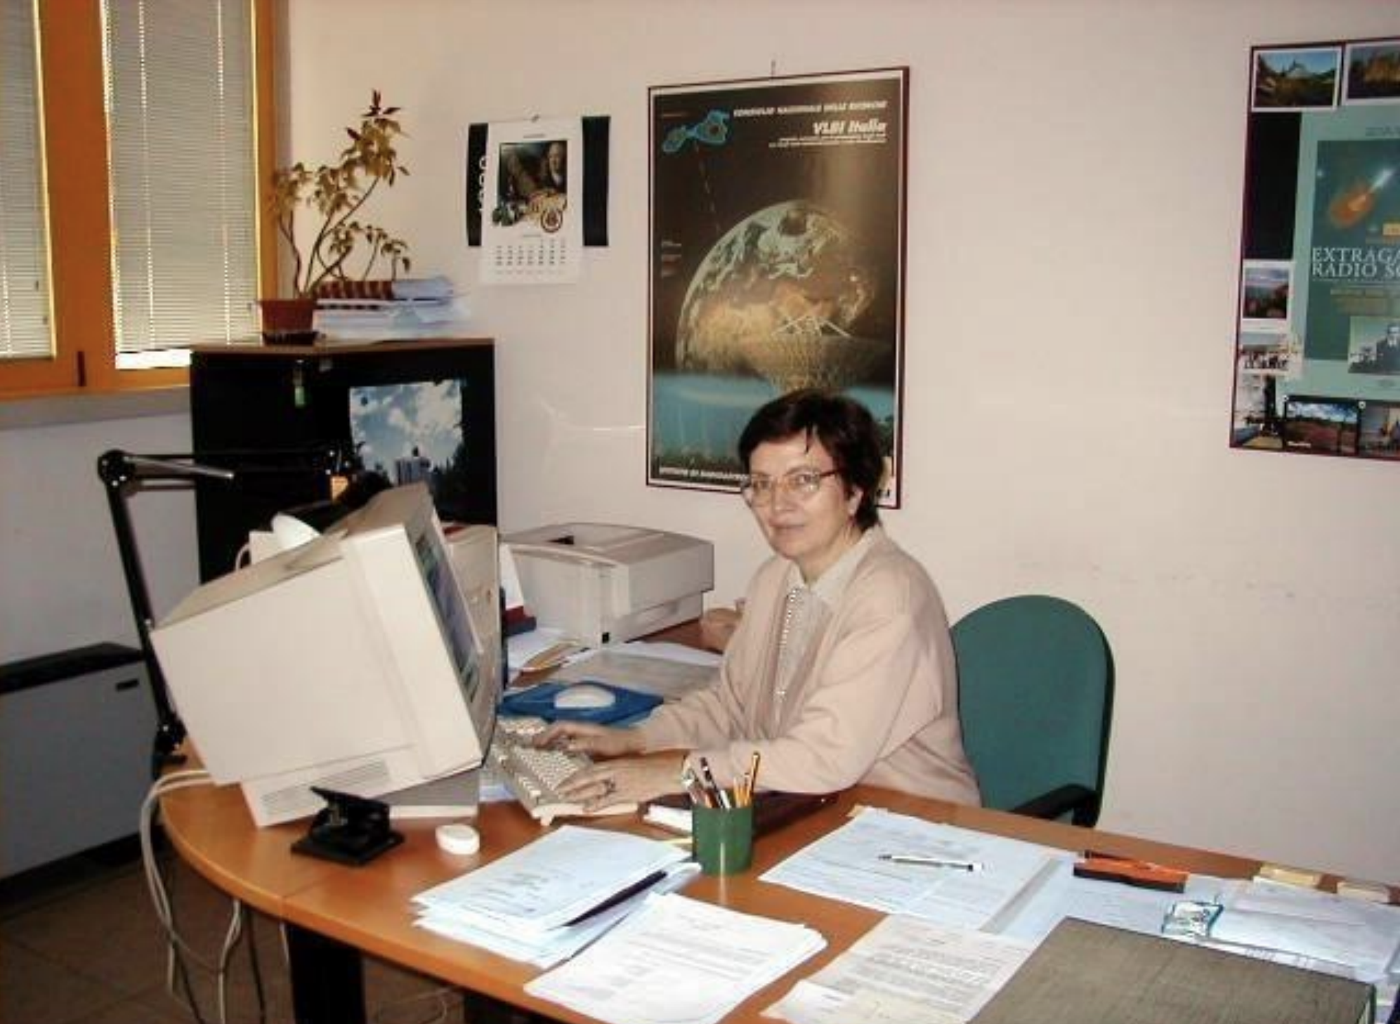
WP3 Tier 1: JIV-ERIC membership
INAF (Italy), founding JIVE partner since 1993
Until 2020: participation in JIV-ERIC on the basis of biennial MoA’s
Since 2021: Italy – a member of JIV-ERIC
New items of collaboration - joint work on advanced projects (e.g., THEZA)
History of radio astronomy in Italy:
https://info.ira.inaf.it/wp-content/uploads/2021/07/Storia-IRA-EnglishVersion1.pdf
First meeting of the EVN CBD, 1985
Lucia Padrielli, 1990s

Slide 5
WP3 implementation: Tier 1
Objectives:
Facilitating joint science, R&D, educational and PO activities with organisations/countries already collaborating with EVN and JIVE;
preparation for admission of the Tier 1 countries in JIV-ERIC.
Partners: countries and organisations already involved in various ways into EVN, JIVE and/or JIVE-related FP7 or other joint activities
Aalto University and Finnish Geospatial Inst., FI
Search for a strong sci case; space science applications most attractive
Center for Astrophysics, N. Copernicus U, Toruń, PL
New leadership at the TCfA
Respective ministries in FI and PL approached by NWO, July 2018
consultations ongoing;
In both countries, national “road maps” have VLBI as important components (2021)
Clearly spelled out position of EVN CBD on JIV-ERIC membership is very important!
Since 2021: representatives of respective organisations are observers at JIVE Council

Slide 6
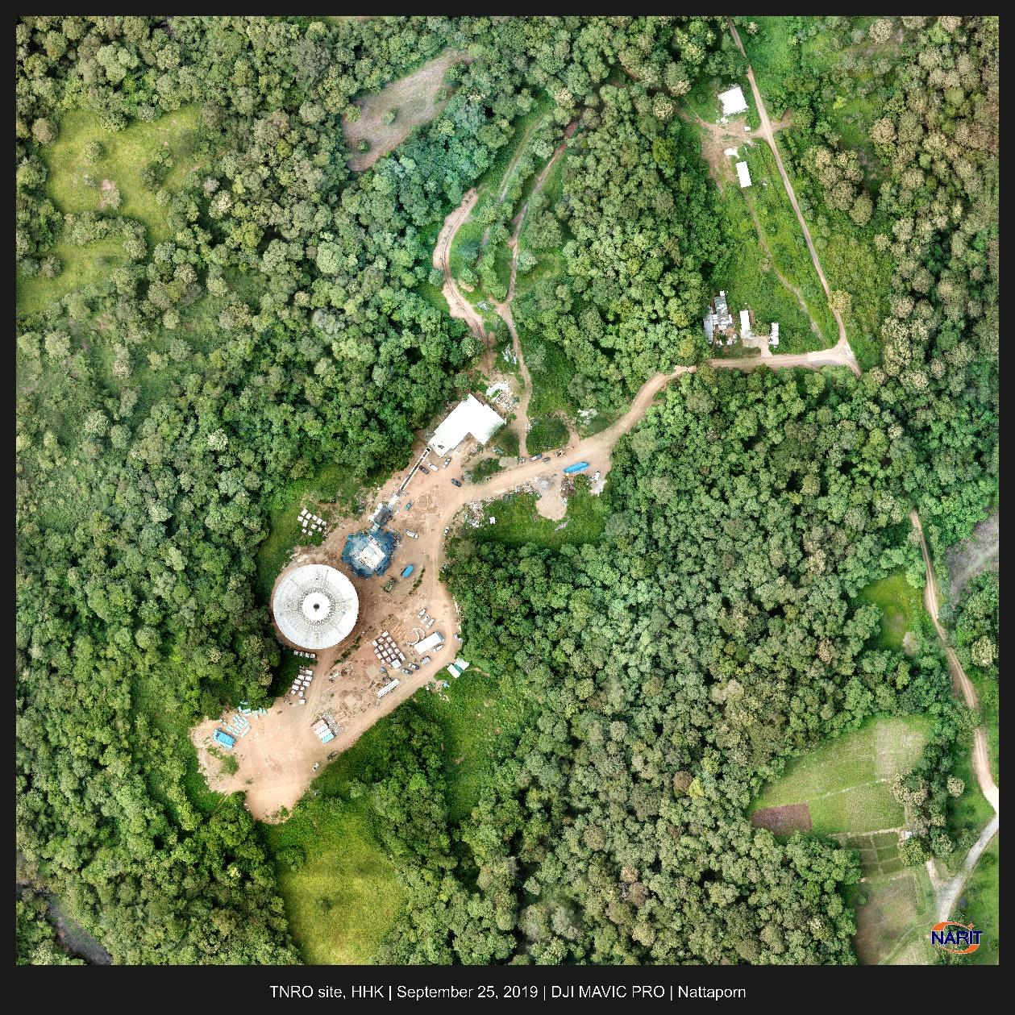
WP3: “Tier 1.5”, Thailand
New radio astronomy facility – a 40-m telescope
Managed by National Astronomical Research Institute of Thailand (NARIT)
40-m radio telescope (a copy of Yebes), TNRT, under construction
Major construction to be completed in 2020
Intention to become an EVN member
NARIT & JIVE MoA signed in Nov 2019
NARIT association with JIV-RIC to commence once the telescope operates

Slide 7
WP3 implementation: Tier 2
Objectives:
ground-work for establishing/broadening of involvement of scientists, engineers and students from Tier 2 countries/organisations in VLBI activities
Partners: organisations involved in VLBI activities consistent with EVN/JIVE mission but not members of either
Konkoly Observatory, Budapest, HU
one of the most active VLBI user groups unaffiliated with EVN
official partner (MoU, 2019) on JUICE VLBI (PRIDE)
Institute of Applied Astronomy, St.Petersburg, RU
major EVN partner
Intertest in strtengthening VLBI sci collaboration with JIVE
Auckland U of Technology, Auckland, NZ
JIVE-AUT MoU (2010+) implementation underway
Interest in Global VLBI Alliance (GVA) cooperation
University of Tasmania, AU
strong interest in GVA
official partner (MoU, 2019) on JUICE VLBI (PRIDE); very helpful in COVID times

Slide 8
WP3 implementation: Tier 3
Objectives:
assistance in creating a case for VLBI research and R&D
assistance in national educational and PO activities
Partners: countries/organisations with declared interest in radio astronomy and VLBI, but without established facilities and/or sizable user groups. Examples:
Santiago University (Aviero) et al., PT
Involvement in SKA, SKA-related technology
VLBI antenna(s) on Azores
Herouni Centre, ROT-54/2.6 telescope, AM
Assistance in resurrection of the existing 54-m radio telescope
Hellenic radio telescope, Thermopilae, GR
Transfer of the satcomm 32-m antenna initiated/supported
National Space Facilities & Control Center, Kyiv - Zolochiv, UA
operational 32-m deep space comm antenna
a well-established radio astronomy school in Kharkiv is assisting

Slide 9
Tier 3, Herouni radio telescope
Joint action of JJ WP3 and WP5 (+ EVN TOG)
Site visit in March 2018
International advisory board under formation (Dec 2019)
54 m “Arecibo-like” radio reflector for dm-mm wavelengths
EC support for partnership to be invoked

Slide 10
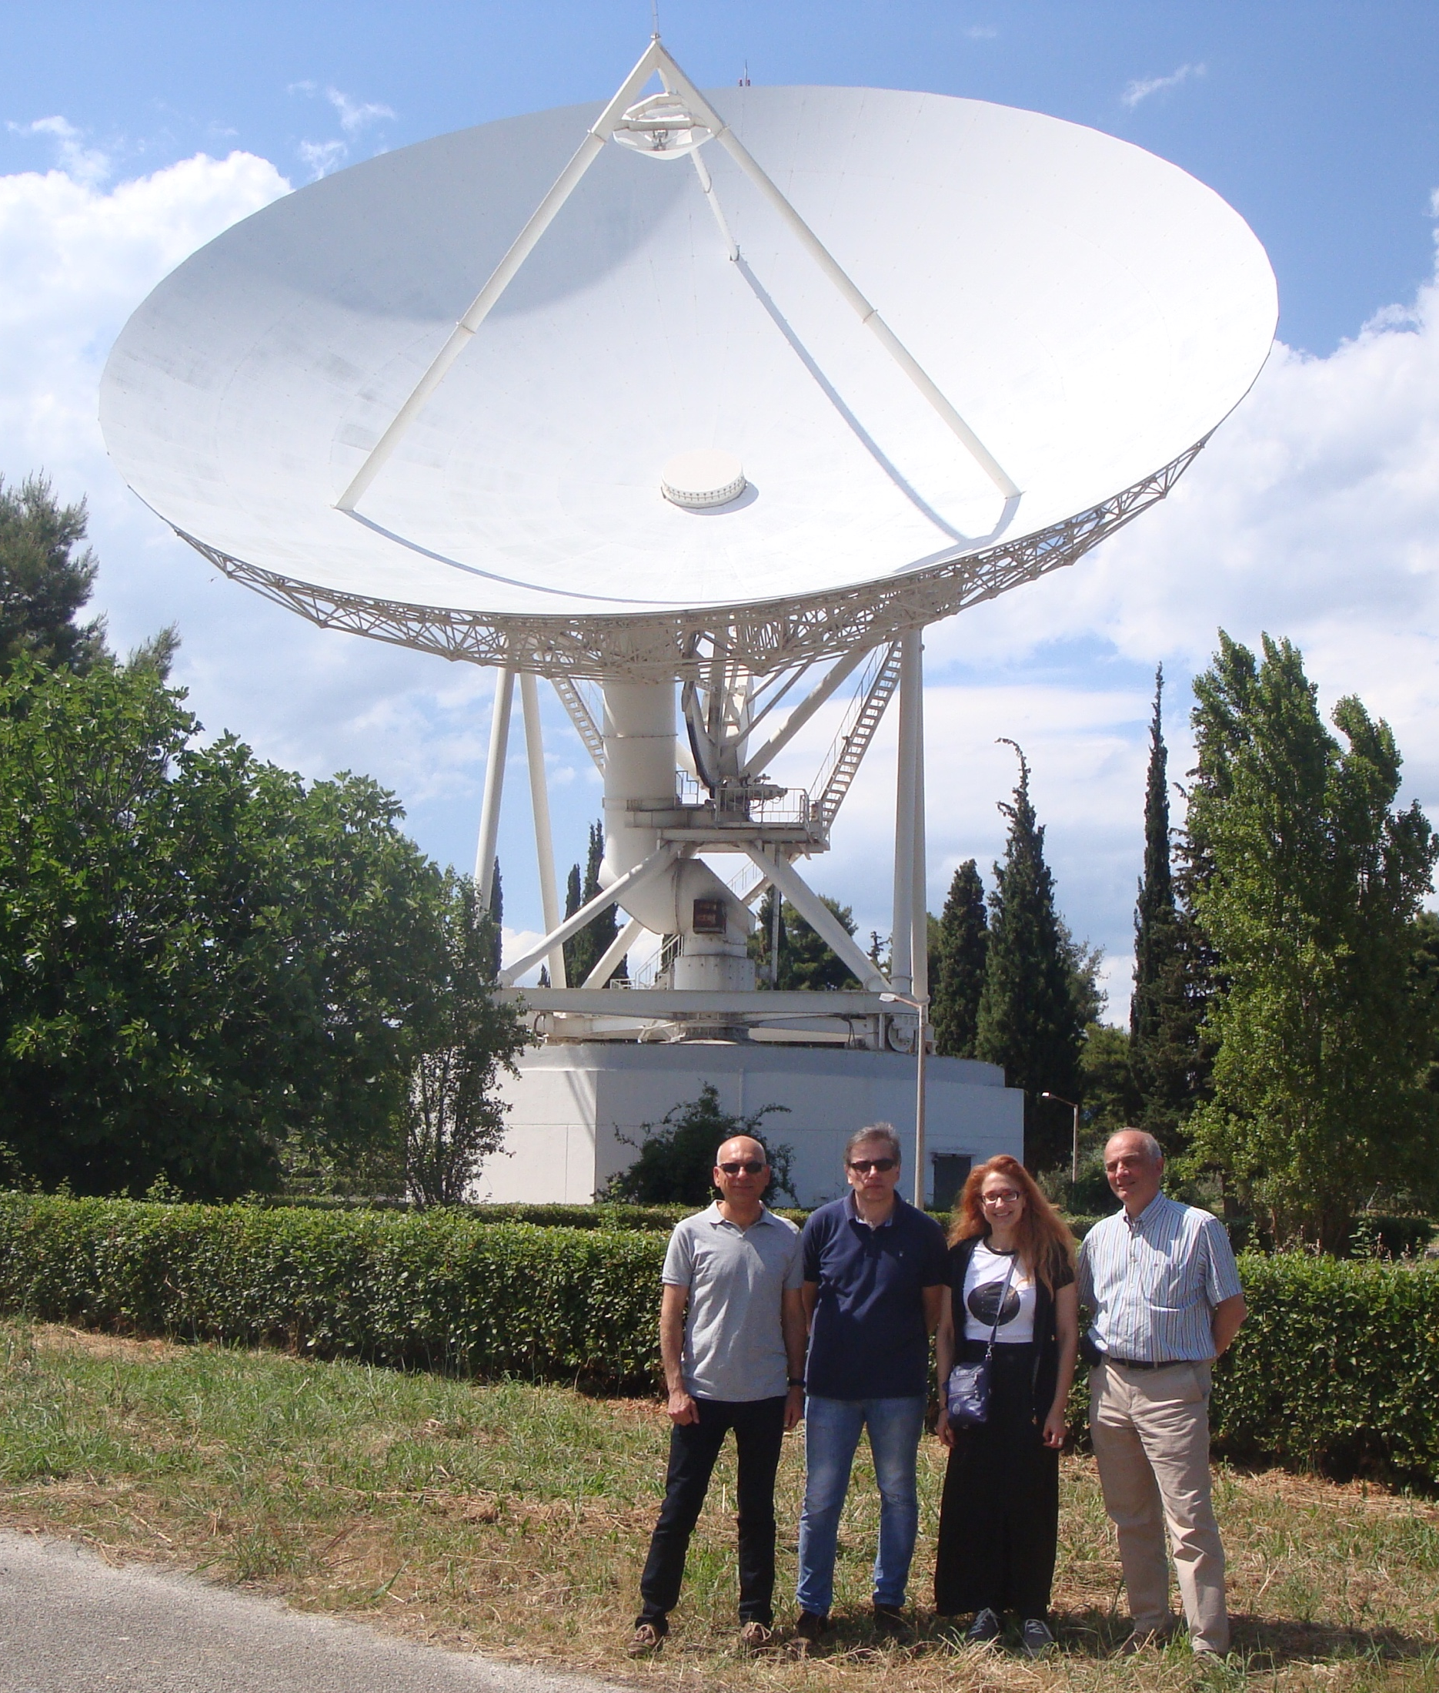
Tier 3, Hellenic radio telescope
32 m Hitachi satcomm antenna
Joint action by JJ WP5 and WP3
Site visit in May 2019 by P. de Vicente and L. Gurvits (repot available)
Formation of a national university alliance underway

Slide 11
Tier 3, Zolochiv radio telescope
Zolochiv 32-m antenna
February 2019
Workshop at the Zolochiv site, Oct 2019
WP3 represented by F. Colomer
32 m deep space comm antenna in good electro-mechanical state
Joint action of JJ WP
Interest to join EVN, eventually – JIV-ERIC
Unclear (national) budgetary arrangements
Important “tutoring” by the Radio Astronomy Institute in Kharkiv (O.Ulyanov et al.)

Slide 12
JJ WP3 final reflections
The formal goals of WP3 achieved (albeit with some deviations from the original activities contents)
… a good sign of flexibility!
25 organisations in 23 countries engaged (see D3.3), more than planned
New partnerships are crucial for development of EVN and JIV-ERIC
… “soft [facilitating] money” come and go, the tasks remain…
JUMPING JIVE is a good example of supporting the natural tasks
ERICs should be eligible for continuing support of WP3-style tasks
an issue for the ERIC Forum?
WP3-like activities will continue in synergies with WP7, WP5 and others
Need for a better and unambiguously formulated administrative requirements:
WP3 is essentially about networking; not suitable for working hours accounting
Personal contacts are essential

