Slide 1
JUMPING JIVE Joining Up users for Maximising the Profile, the Innovation and the Necessary Globalisation of JIVE
Francisco Colomer
JIVE Director
JJ Coordinator

Slide 2
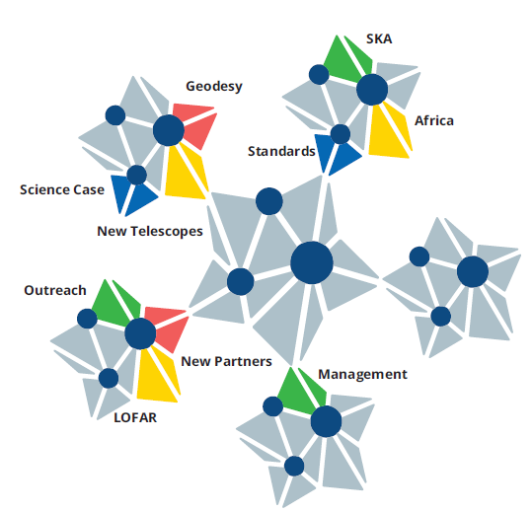
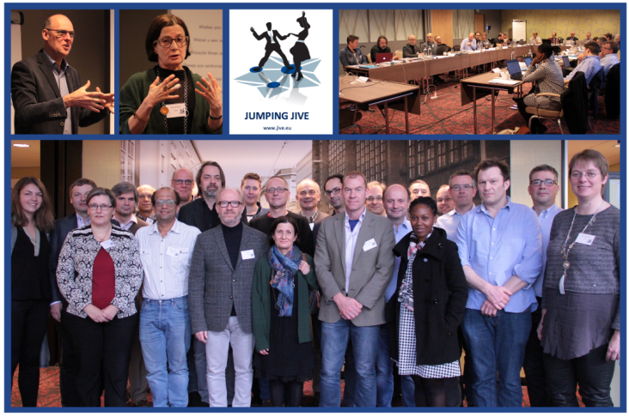
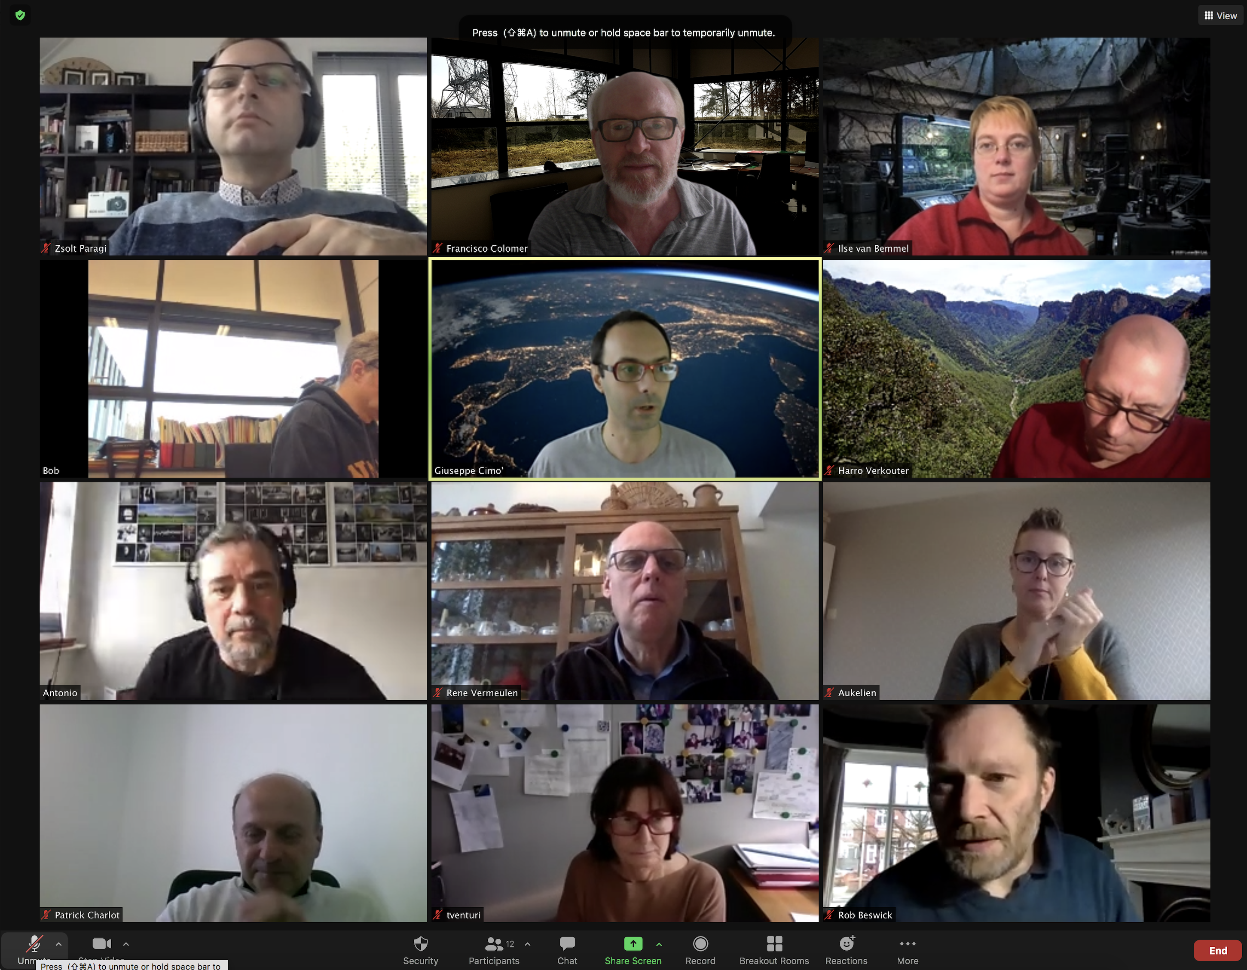
JUMPING JIVE objectives:
to strengthen JIVE, advocate its services and enlarge its partnerships, in preparation for global VLBI in era of multi-messenger astrophysics
Technical developments
Towards
the future
Exec meeting – 2021
Sustainable JIVE
Kick off – 2017
Management

Slide 3
Objectives of JUMPING JIVE
Advance in the sustainability of JIVE
WP2: Outreach and advocacy
WP3: New partnerships
WP4: ILT-JIVE synergies
Develop new capabilities
WP5: Integrating new elements
WP6: Geodetic capabilities
WP8: Global VLBI interfaces
Towards the future of VLBI
WP7: VLBI future and vision
WP9: VLBI in Africa
WP10: SKA-VLBI

Slide 4
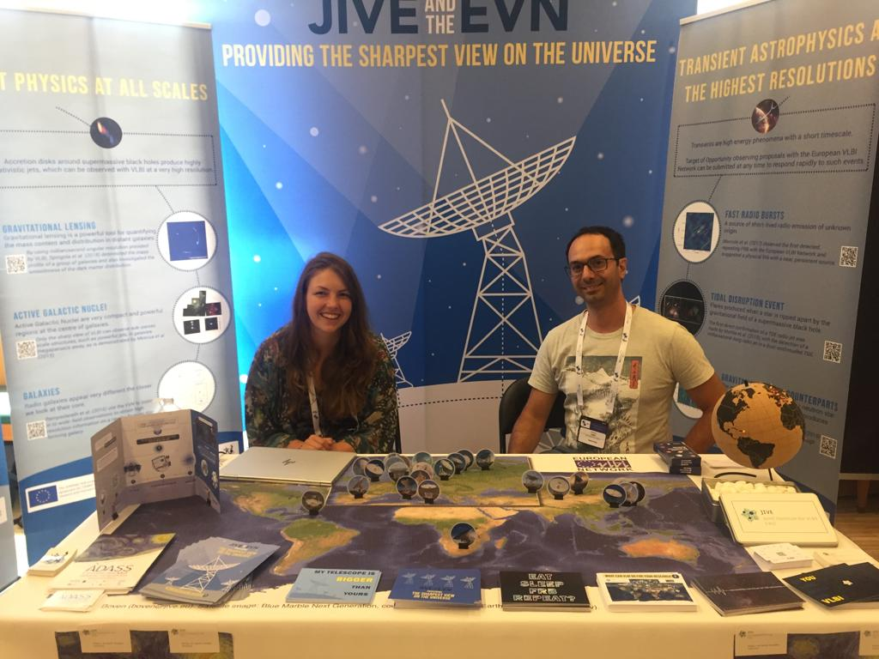
Towards a sustainable JIVE
JUMPING JIVE reached:
Thousands astronomers
Hundreds policymakers
Hundred thousands public
Establishment of:
EVN and JIVE as open and welcoming community
JIVE as high-quality support center for expert and new users
EVN science capability presented to a wider community
Continuous building an EVN outreach community and communication strategy
Notes:
The goal of WP2 is to ensure that JIVE and EVN have a solid basis for growing into a global VLBI facility. We need to make people aware of the unique capabilities of the EVN and the support provided by JIVE to use the EVN. At policy level we need to generate awareness of the benefits of JIVE and the EVN for a country, an institute, an observatory. Having a large user base in a country will help with this.

Slide 5
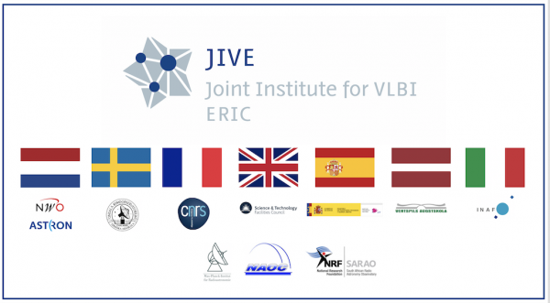
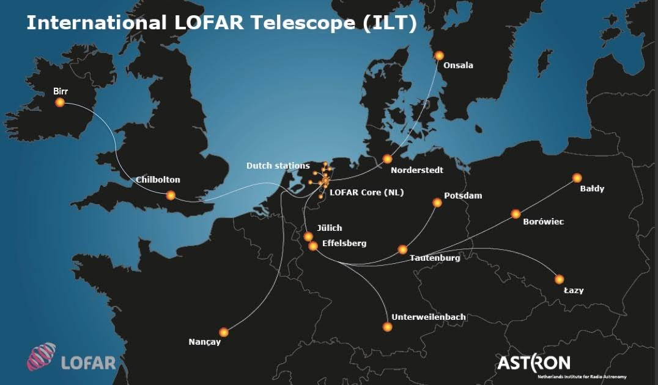
Towards a sustainable JIVE
Building new Partnership (and strengthening existing ones) for VLBI and JIVE:
Latvia and Italy new JIV-ERIC members
MoU with Hungary, Thailand and Australia
Support uGMRT (India), Arecibo 2.0,…
VLBI and EVN included in Finnish and Polish roadmaps for astronomy
Several potential institutes/countries approached to start and strengthen new partnerships
JUMPING JIVE assessment of a closer operational alignment of JIVE and the ILT helped with:
decision to apply for LOFAR-ERIC
highlighting synergies for future collaborations as astronomical ERICs within the European research infrastructure landscape

Slide 6
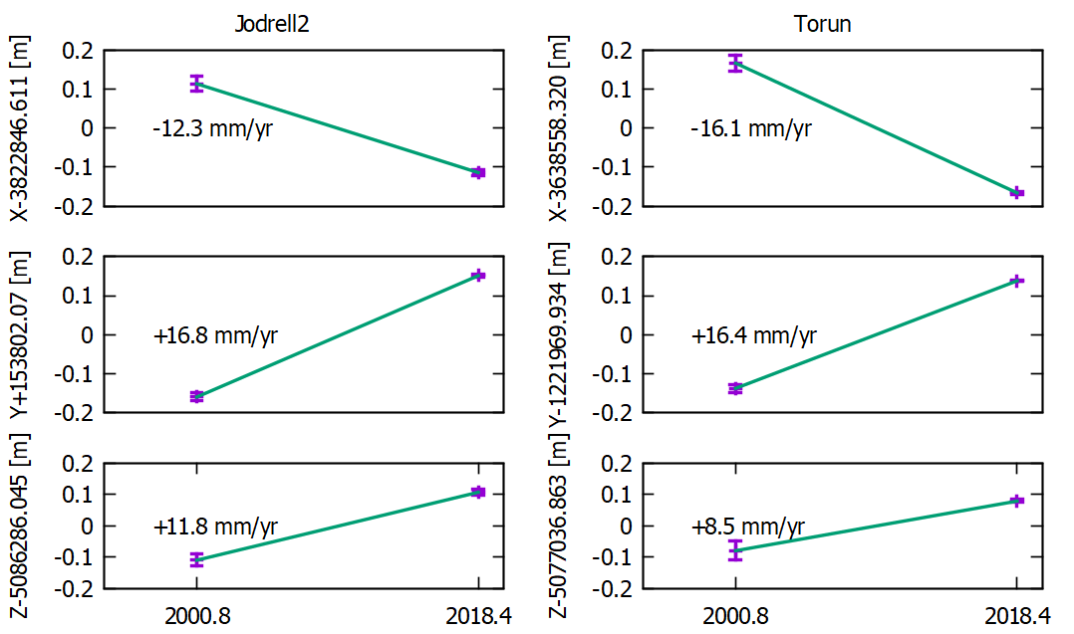
Technical developments
Enhancements of existing EVN stations & affiliated stations
New equipment at existing stations and New stations: Kuntunse (Ghana), eMerlin (3 stations), Santa Maria (Azores) & fringes to MeerKat.
Implementation of station feedback from pipeline and archive
List of potential new telescopes includes:
NARIT 40m (Thailand)
uGMRT (India)
ROT 54/2.6 (Armenia)
Zolochiv 32-m 32-m(Ukraine)
Enabled geodetic use of EVN correlator
Full scale geodetic EVN observations
More accurate positions of EVN stations
Positional changes of EVN stations

Slide 7
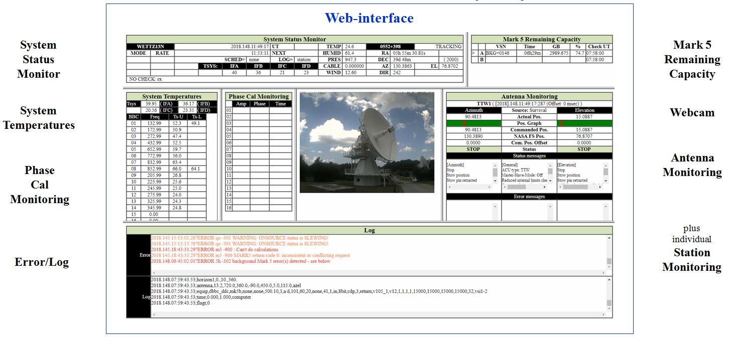
Technical developments
VLBI depends on seamless interaction of different telescopes, equipment, locations,…
Scheduling of the array
Re-factored of existing legacy code using Python
Now it is easier to adapt, maintain and extend
Monitoring of the array
Central web-based system
Enabling automated warnings in case of failures
Provide information needed to continuously improve performance

Slide 8
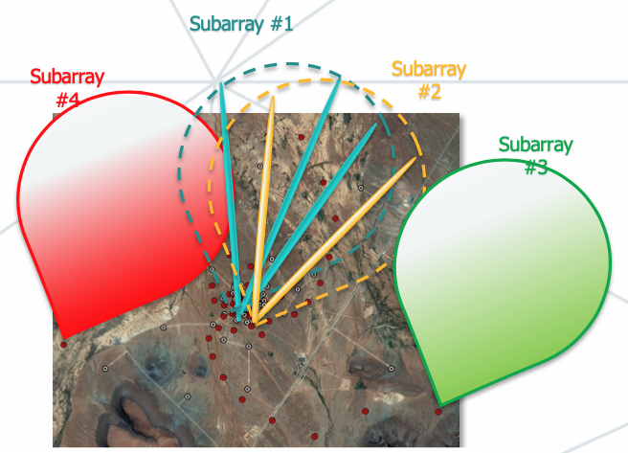
Towards the future
The scientific roadmap for VLBI in the next decade, has involved over 80 experts in the area of astrophysics, covering a worldwide geographical distribution and a reasonably balanced gender representation.
state of the art in all fields which can be reached out by VLBI
scientific prospects for the next decade
Technical roadmap is following
Wide dissemination to scientists, officers and stakeholders
presented at many international meetings
distributed in hard copy
VLBI with the SKA
Provided support for VLBI-SKA integration and operations
SKA-VLBI project scientist embedded at SKAO
Portfolio of SKA-VLBI science (collaborate with SKA-VLBI WG)
Definition of the interfaces between VLBI arrays and SKA

Slide 9
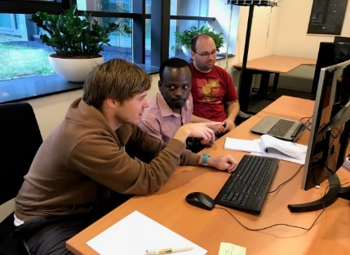
Towards the future
Capacity for VLBI in Africa Cooperation with African partners (+ DARA)
Multiple EU experts involved
Lecturing tours from EU to DARA countries
Advocating widely radio astronomy and VLBI (and JIVE and the EVN)
Courses in Ghana, Kenya, Namibia/Botswana, Zambia, Mozambique & South Africa
Fund travel and other initiatives, affected by COVID-19
Multiple new doctoral and postdoctoral researchers
hundreds graduate-level students across 8 African countries
Wider societal benefits in these new communities

Slide 10
JUMPING JIVE
JUMPING JIVE has been an ambitious series of initiatives
Overarching aim to maximise the potential for VLBI in all areas via
Advocating
Expanding
Innovating
Starting point for sustained JIVE activities!!!
SUCCESS!!!

