Slide 1
JUMPING JIVE – WP1 Joining Up users for Maximising the Profile, the Innovation and the Necessary Globalisation of JIVE
Giuseppe Cimò
Project Manager

Slide 2
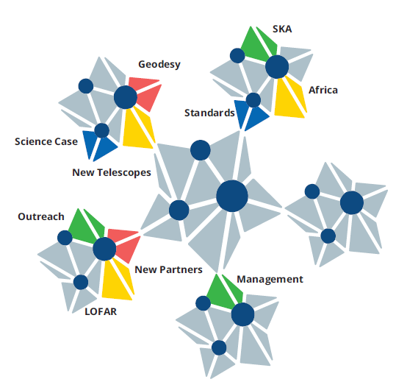
JUMPING JIVE WP1
Work package 1 has the managerial duties of the project
Budget: 2,983,682.50 Euro
Duration: 50 + 6 months (from December 2016 to July 2021)
Coordinator: Paco Colomer
Project Manager: Giuseppe Cimò
Project Scientist: Ilse van Bemmel
Finance Officer: Aukelien van den Poll
10 Work Packages
12 Partners: JIV-ERIC, CNRS, CTH, DST, INAF, MFOM, SKAO, ASTRON, ILT, TUM, UNIVLEEDS, UMAN
Technical developments
Towards
the future
Sustainable JIVE
Management

Slide 3
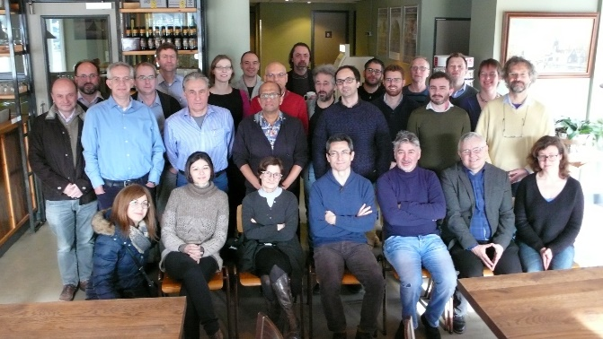
Project Management
Constant communication with other WP leaders
Facilitated communication and interactions between WPs
Monitored deviations
4 Amendments
Collection of the project deliverables for the EC portal
Quality assurance
Plan of timeline for reports
Monitored of finances
Managed the Central travel budget
Executive Board meetings (via telecons) every two or three months
Board meetings once per year (in-person and remote):
Logistical assistance for other WPs’ events/activities
WP1 had only one formal deliverable (2 removed with an amendment)

Slide 4
Project Management
…in the Time of Corona
At the end of the second period, the coronavirus disease has started to spread around the world limiting travels and event organizations.
The JUMPING JIVE consortium promptly started to monitor the development:
consulted with the EC Project Officer
adopted all the necessary measures to mitigate disruption
Requested 6-month extension
The CoViD-19 pandemic had a sensible effect on the use of the budget and the completion of the action. In particular, travelling and organization of the planned meetings, schools and other activities.
Mitigation measures:
moving supported meetings to online workshops
focussing more on local efforts to complete the work
Some resources originally allocated in travels and other activities limited by CoVid-19 could be used to pay for personnel expenses because of the different effort involved in the activities.

Slide 5
Finances
Central travel budget to complement WP travel budgets
Periodic checks on the central travel budget Closer look at the travel budget during the pandemic
Yearly financial exercises
to provide an integrated report for the project with projections.
in preparation for the official periodic reports
to keep track of general spending
last financial exercise in summer 2020 during the pandemic
Spending kept under control
Notes:
The goal of WP2 is to ensure that JIVE and EVN have a solid basis for growing into a global VLBI facility. We need to make people aware of the unique capabilities of the EVN and the support provided by JIVE to use the EVN. At policy level we need to generate awareness of the benefits of JIVE and the EVN for a country, an institute, an observatory. Having a large user base in a country will help with this.

Slide 6
Finances – Total claim
The project spent the whole requested budget.
The COVID-19 pandemic resulted in less other direct costs and more effort spent in personnel.
The total claim is higher than the budget because of more expenses in personnel.
Notes:
The goal of WP2 is to ensure that JIVE and EVN have a solid basis for growing into a global VLBI facility. We need to make people aware of the unique capabilities of the EVN and the support provided by JIVE to use the EVN. At policy level we need to generate awareness of the benefits of JIVE and the EVN for a country, an institute, an observatory. Having a large user base in a country will help with this.

Slide 7
In conclusion
The project has carried out all work as described in the Grant Agreement:
All deliverables submitted as planned
All allocated budget spent
Deviations from original plan addressed on time in amendments
Extension due to COVID-19
Mitigation measurements worked as expected
Future work:
Dissemination and exploitation of the project’s results
Webpages jumping.jive.eu

Slide 8
Finances ALL JJ WP

Slide 9
JUMPING JIVE – All finances (I)

Slide 10
JUMPING JIVE – All finances (II)

