Slide 1
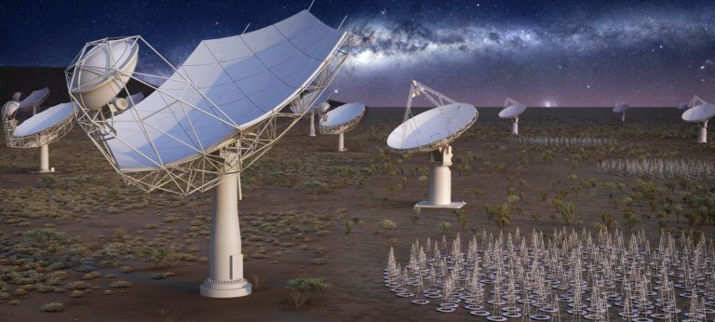
Enhancing the Square Kilometre Array with VLBI angular resolutions
Cristina García Miró
JIVE

Slide 2
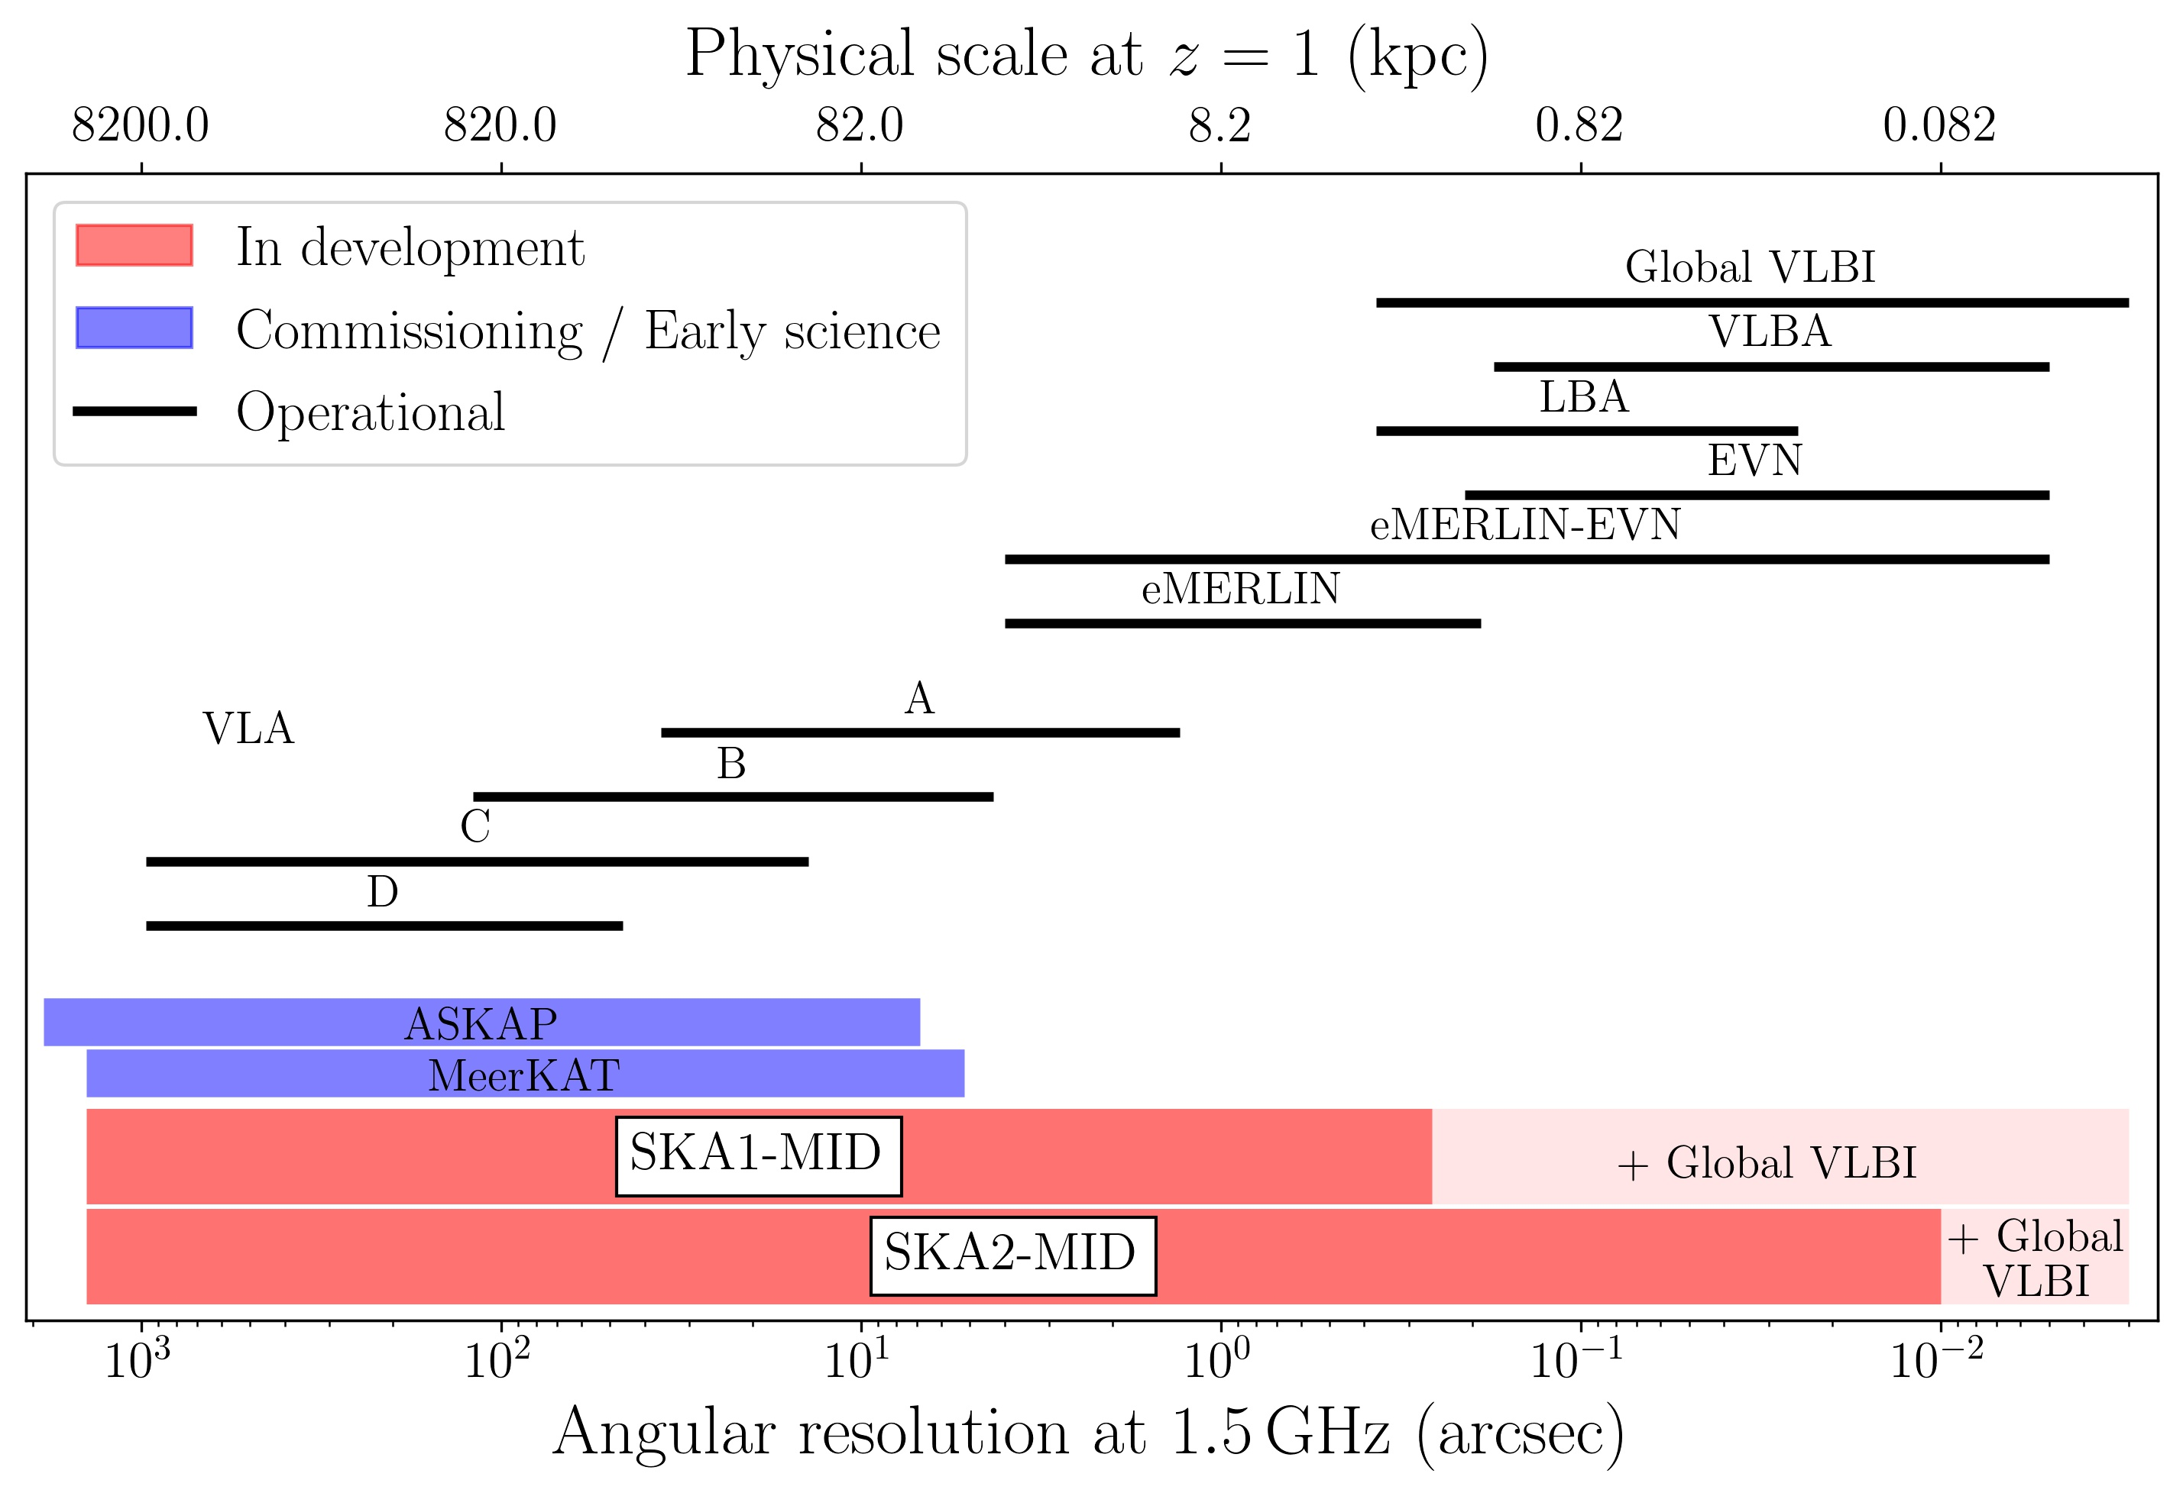
Why VLBI with the SKA?
Credit: Jack Radcliffe

Slide 3
Why VLBI with the SKA?
Credit: Jack Radcliffe

Slide 4
Why VLBI with the SKA?
mas
resolutions
SKA2 science!
Credit: Jack Radcliffe

Slide 5
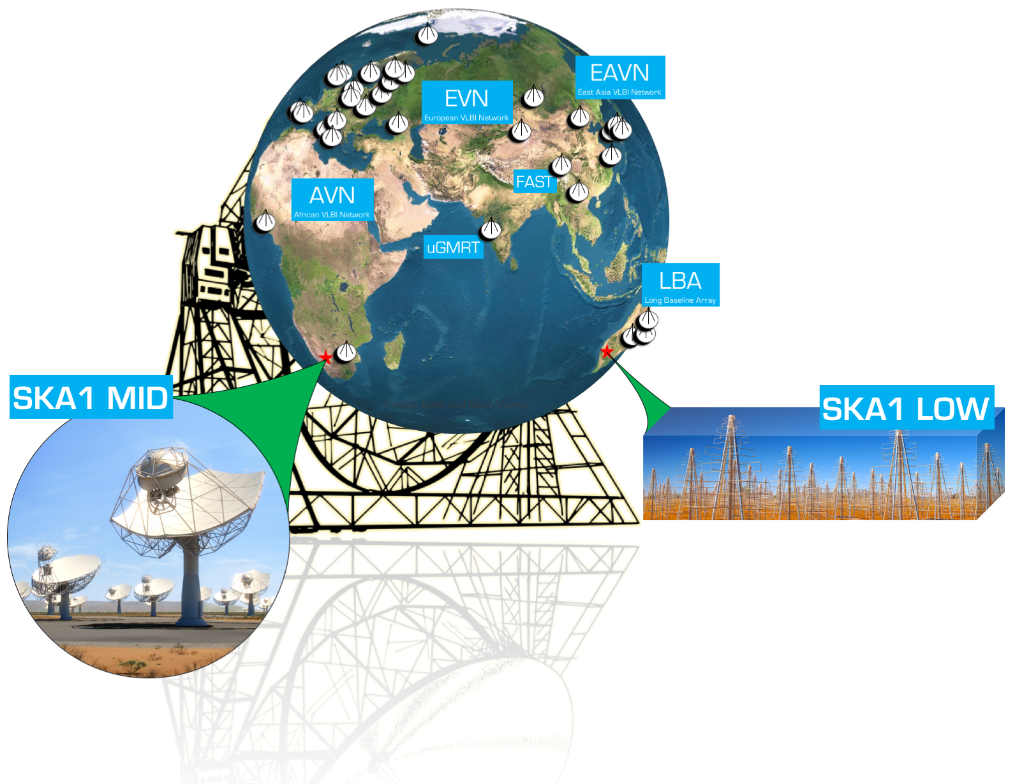
Why VLBI with the SKA?

Slide 6
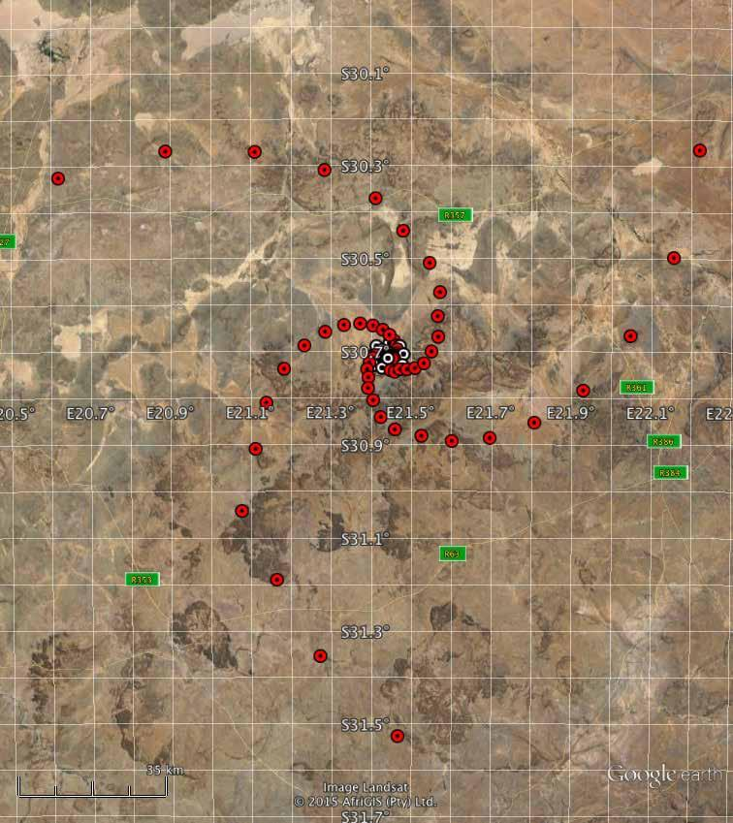
Why VLBI with the SKA?
SKA provides …
Independent MULTI-BEAM CAPABILITY
BOOST in SENSITIVITY to µJy regime
Access to SOUTHERN SKIES and GC
COMMENSALITY with other modes
Superior AMPLITUDE & POLARISATION calibration
4 km
(67-75%)
20 km
(83-87%)
35 km
full array (100%)

Slide 7
Why VLBI with the SKA?
SKA provides …
Independent MULTI-BEAM CAPABILITY
BOOST in SENSITIVITY to µJy regime
Access to SOUTHERN SKIES and GC
COMMENSALITY with other modes
Superior AMPLITUDE & POLARISATION calibration
4 km
(67-75%)
VLBI provides …
Images of sky at BROAD RANGE of ANGULAR SCALES RESOLUTIONS
mas resolution for SKA HPSOs
Independent COMMISIONING TOOL and early PR OPPORTUNITIES
AN ENTHUSIASTIC USER COMMUNITY
20 km
(83-87%)
35 km
full array (100%)

Slide 8
JUMPING JIVE Project
“Joining up Users for Maximizing the Profile, the Innovation and Necessary Globalization of JIVE”
European Union’s H2020 research and innovation programme under grant agreement No 730884
Work package 10: “the SKA”
Provide support for SKA integration and operations within a VLBI array
Led by Zsolt Paragi (JIVE) and Antonio Chrysostomou (SKAO)
SKA-VLBI project scientist (Cristina García Miró) at SKAO (currently at JIVE)
Cyg A (McKean et al. 2016)

Slide 9
JUMPING JIVE Project
“Joining up Users for Maximizing the Profile, the Innovation and Necessary Globalization of JIVE”
European Union’s H2020 research and innovation programme under grant agreement No 730884
Work package 10: “VLBI with the SKA”
Provide support for SKA integration and operations within a VLBI array
Led by Zsolt Paragi (JIVE) and Antonio Chrysostomou (SKAO)
SKA-VLBI project scientist Cristina García-Miró (SKAO - currently at JIVE)
Cyg A (McKean et al. 2016)

Slide 10
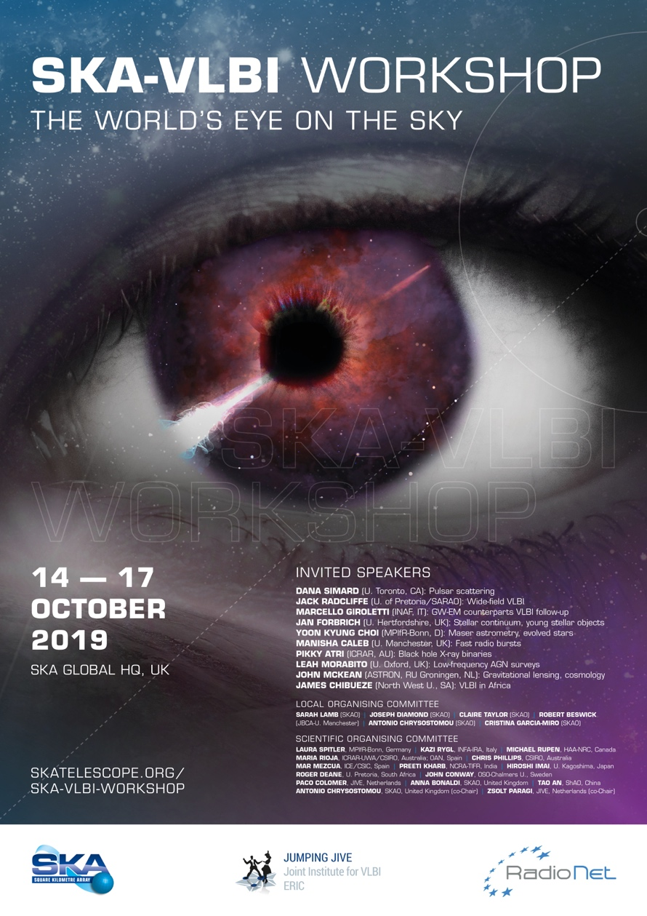
What SKA-VLBI can do for my science?

Slide 11
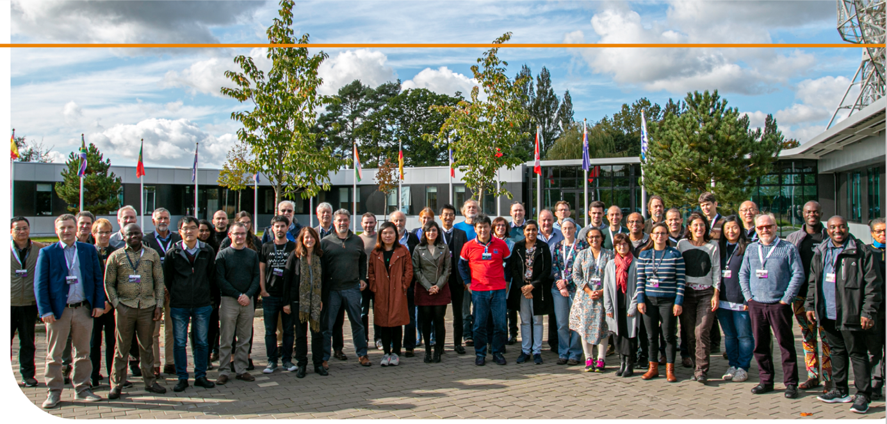
What SKA-VLBI can do for my science?

Slide 12
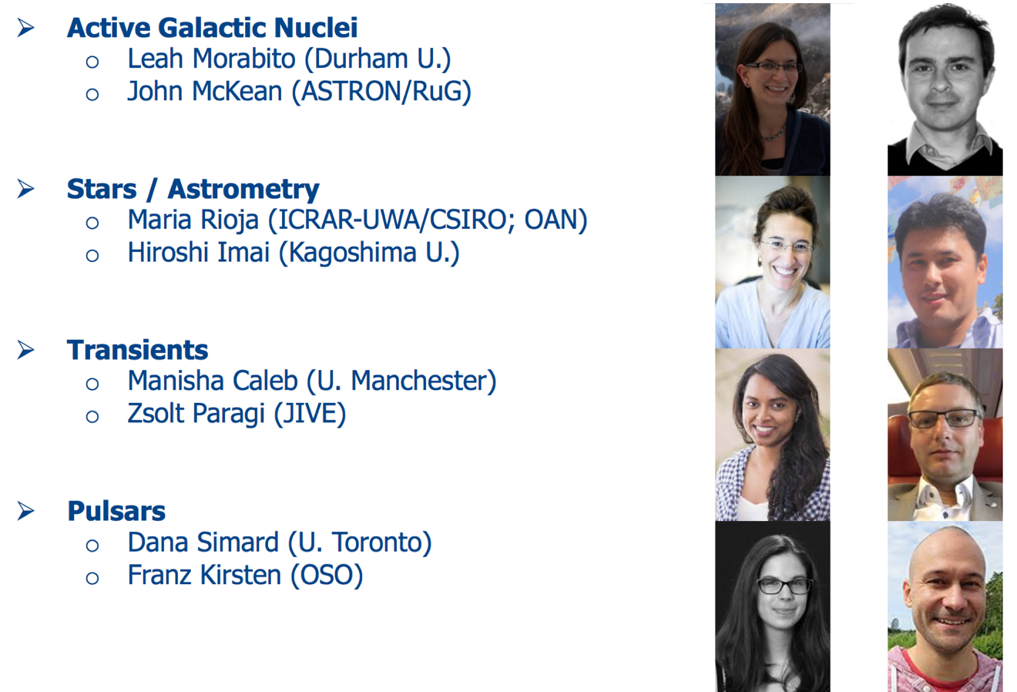
What SKA-VLBI can do for my science?
SKA-VLBI KEY SCIENCE PROJECTS
WORKING GROUPS

Slide 13
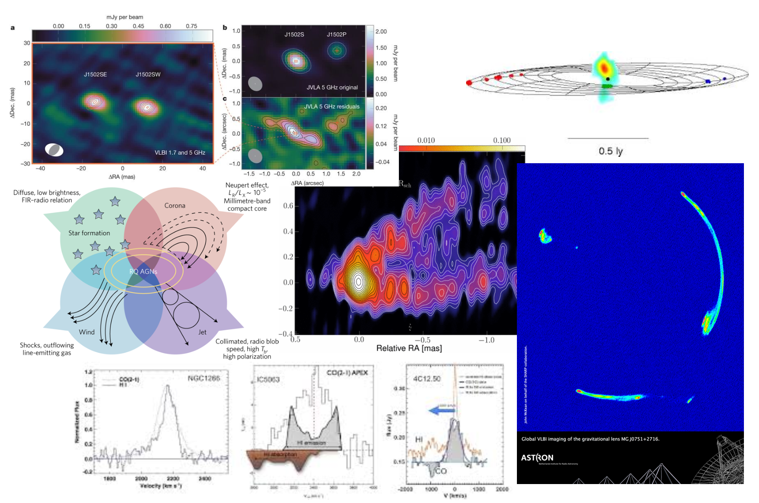
What SKA-VLBI can do for my science?
GALAXIES and AGNs: Key Science Themes

Slide 14
What SKA-VLBI can do for my science?
GALAXIES and AGNs: Key Science Themes
BH/Cosmology
AGN/SF separation
Jet physics
SMBH evolution
Dark matter
AGN Feedback/Fuelling
Cyg A (McKean et al. 2016)

Slide 15
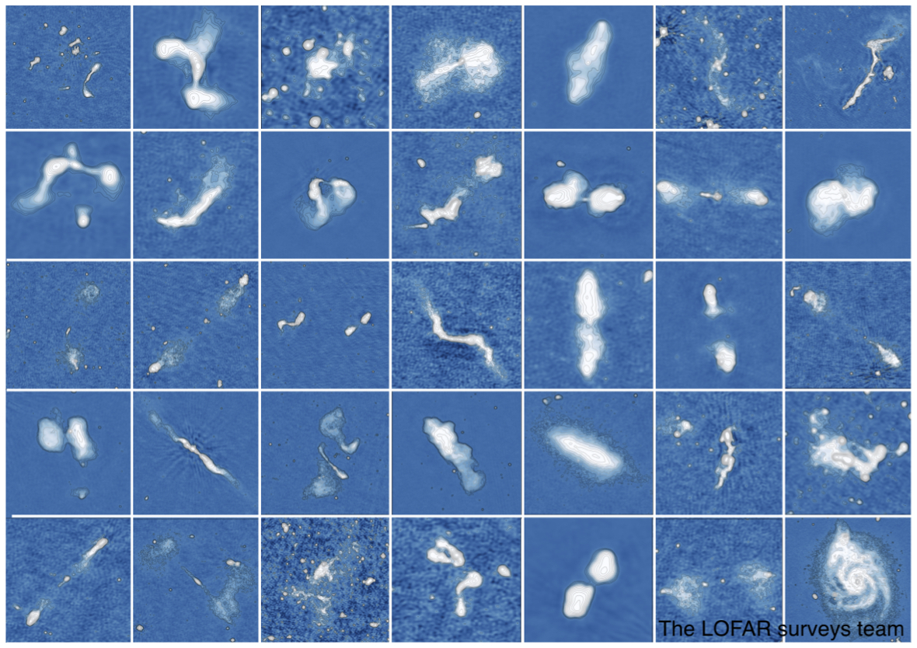
What SKA-VLBI can do for my science?
GALAXIES and AGNs
SKA-VLBI
high resolution + sensitivity + low freqs
Unique probe for
AGN science
AGN/SF disentanglement
FRI vs. FRII characterisation
Radio loud AGN: physics of hot-spots (spectral modelling)
Radio quiet AGN: origin of radio emission, core identification and small scale jets or winds, gravitationally lensed galaxies
Build a sample of resolved high-z AGN
AGNs at lower frequencies (~MHz):
LoTSS - LOFAR Two-metre Sky Survey
Shimwell et al. 2019, Williams et al. 2019,
Duncan et al. 2019; Special volume A&A Feb 2019

Slide 16
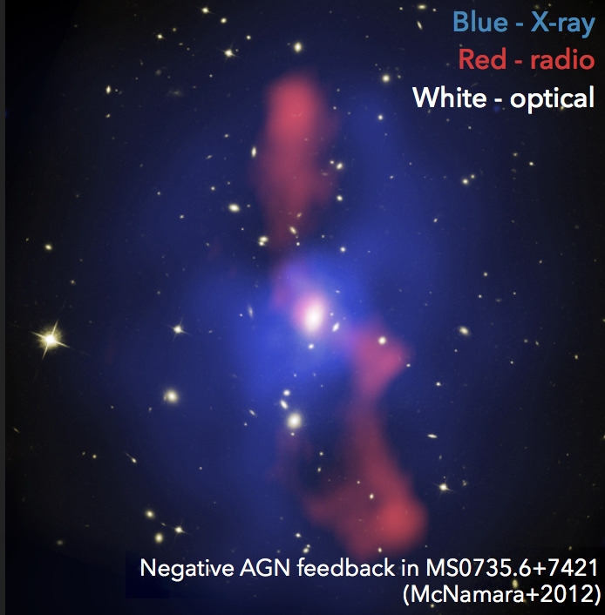
What SKA-VLBI can do for my science?
SKA-VLBI
high resolution + sensitivity + multiple beams
How is the VLBI sky at < µJy sensitivities?
SKA deep-field surveys with targeted SKA-VLBI beams to extract radio/AGN science
Plenty of science to exploit!
Co-evolution → Feedback between SMBH and host galaxy
Radio emission traces both SF/AGN activity
The VLBI method detects the largest number of AGN: VLBI wide-field surveys for AGN finder
but also for: SMBH binaries, gravitational lenses, radio SNe, LLAGN…
GALAXIES and AGNs

Slide 17
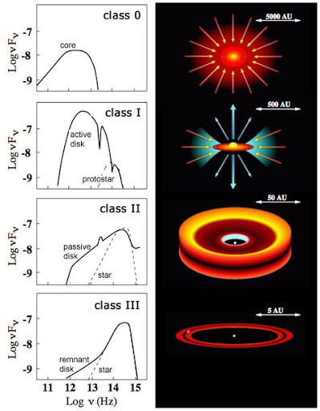
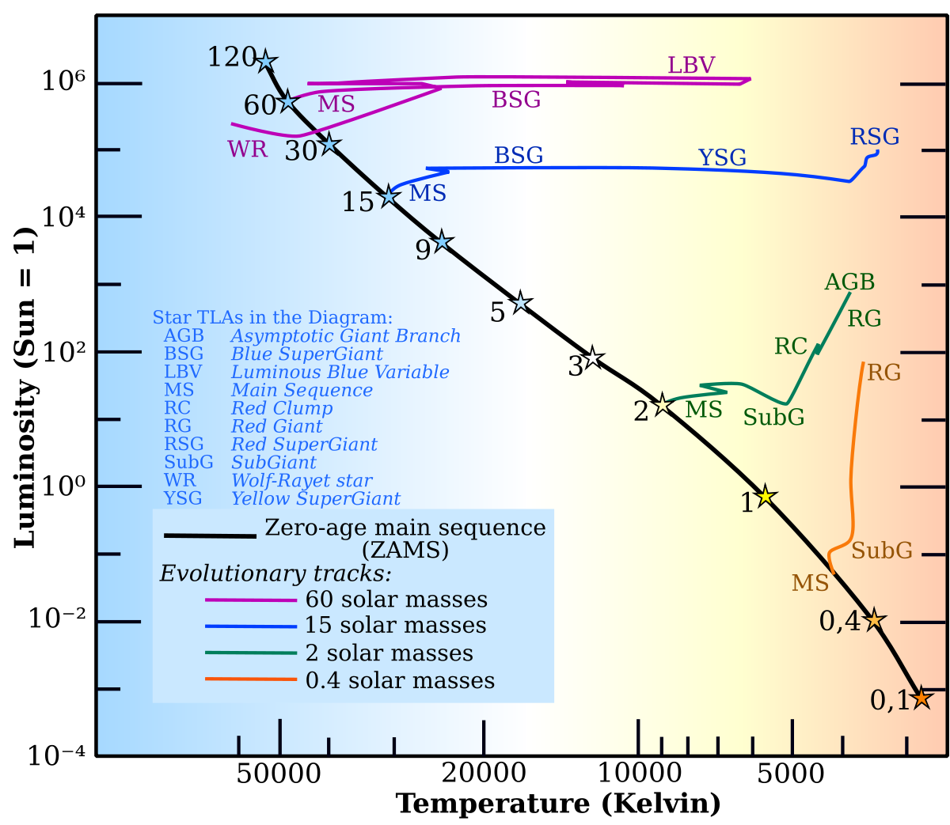
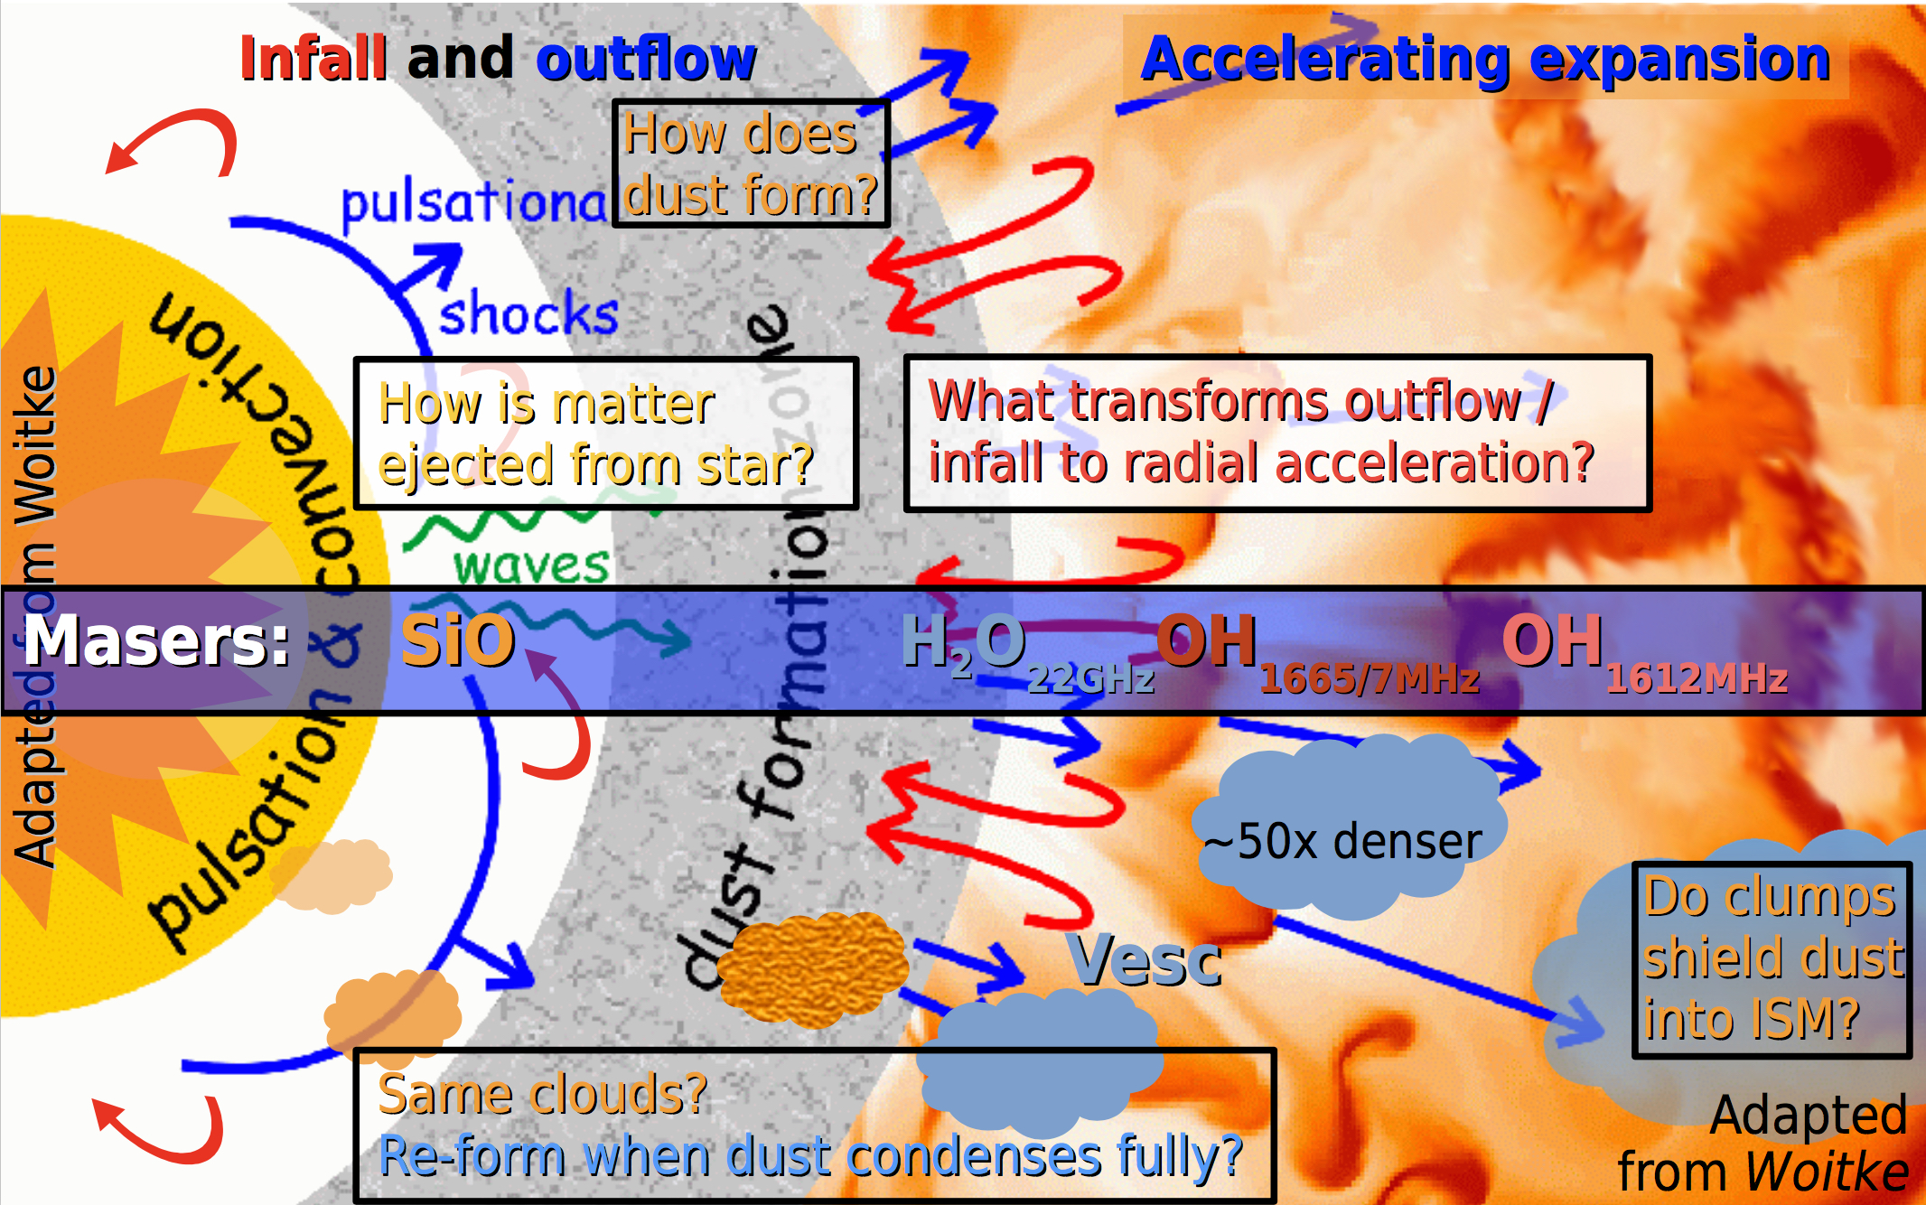
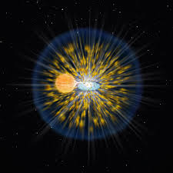
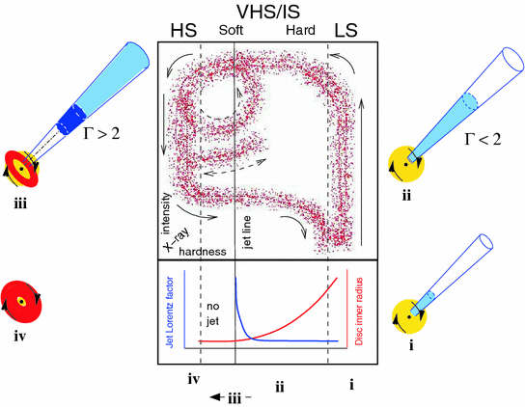
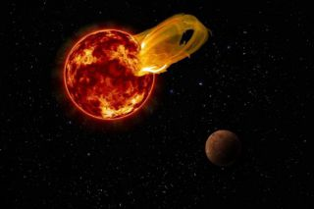
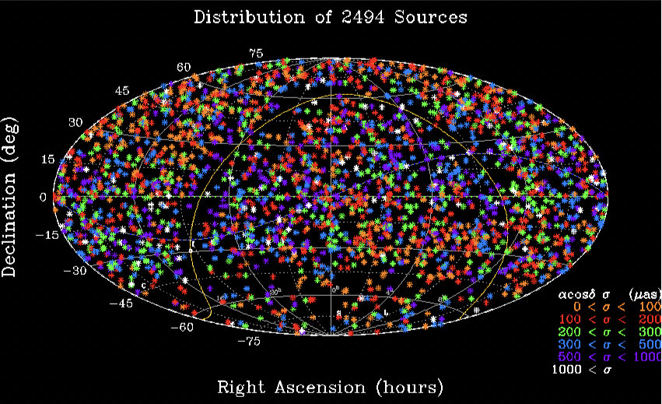
What SKA-VLBI can do for my science?
STARS/ Astrometry: Key Science Themes
Adapted
from Isella
Quiroga-Nuñez et al., 2017
Jacobs et al., 2018

Slide 18
What SKA-VLBI can do for my science?
STARS/ Astrometry: Key Science Themes
Evolved
stars
Young
stellar
objects
Stellar evolution
Adapted
from Isella
Dynamics
clusters/
local galaxies
Explosions
/ novas
Quiroga-Nuñez et al., 2017
Stellar jets /
outflows
Flares /
exoplanets
Jacobs et al., 2018
Global
Astrometry

Slide 19
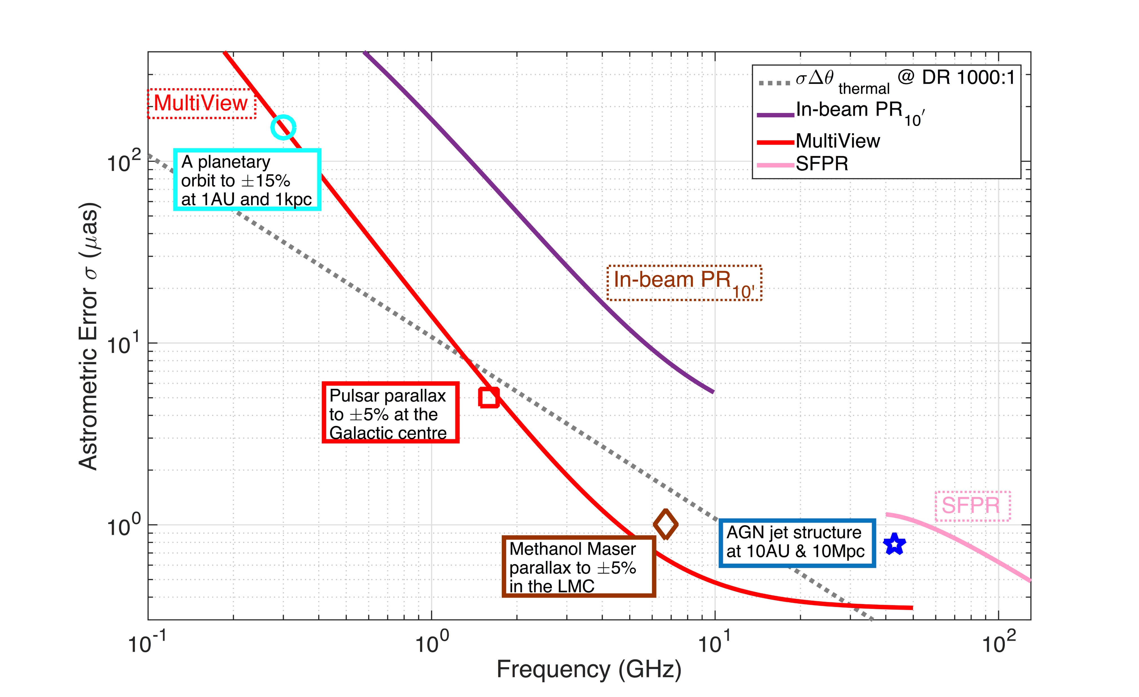
What SKA-VLBI can do for my science?
STARS/ Astrometry
SKA-VLBI
Most powerful tool for astrometry
(distances + proper motions + multiple beams)
New phase calibration techniques “Multi-view” (Rioja et al. 2017)
for >6GHz → 1µas
reach thermal noise limit
Ultimate astrometric accuracy + dramatic increase of # targets →
New discoveries!
Rioja & Dodson, AARv ‘20 in prep.

Slide 20
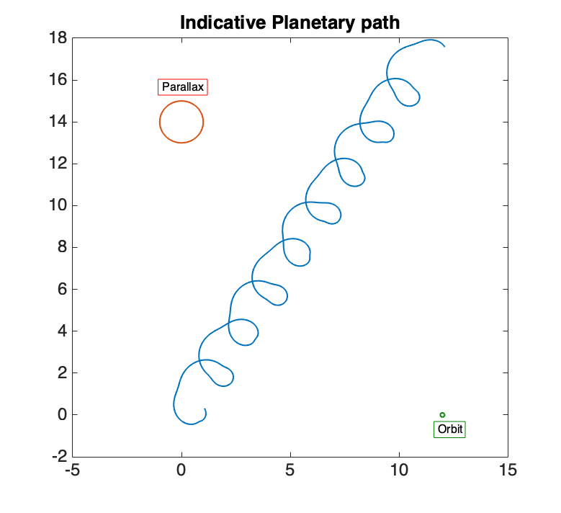
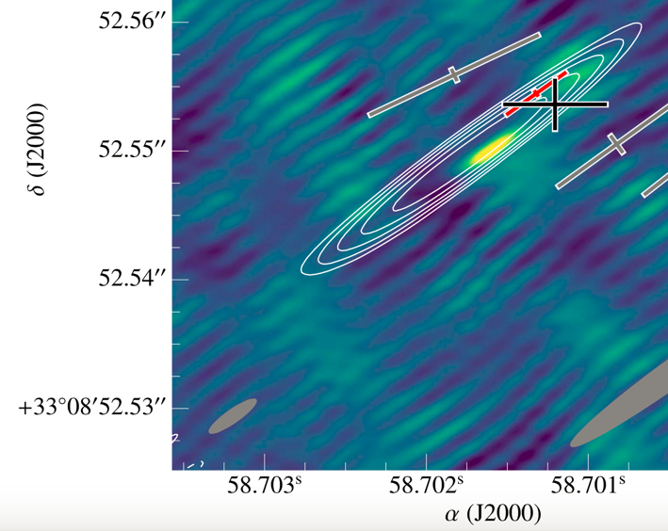
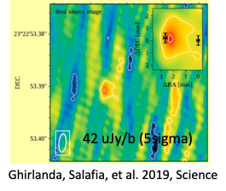
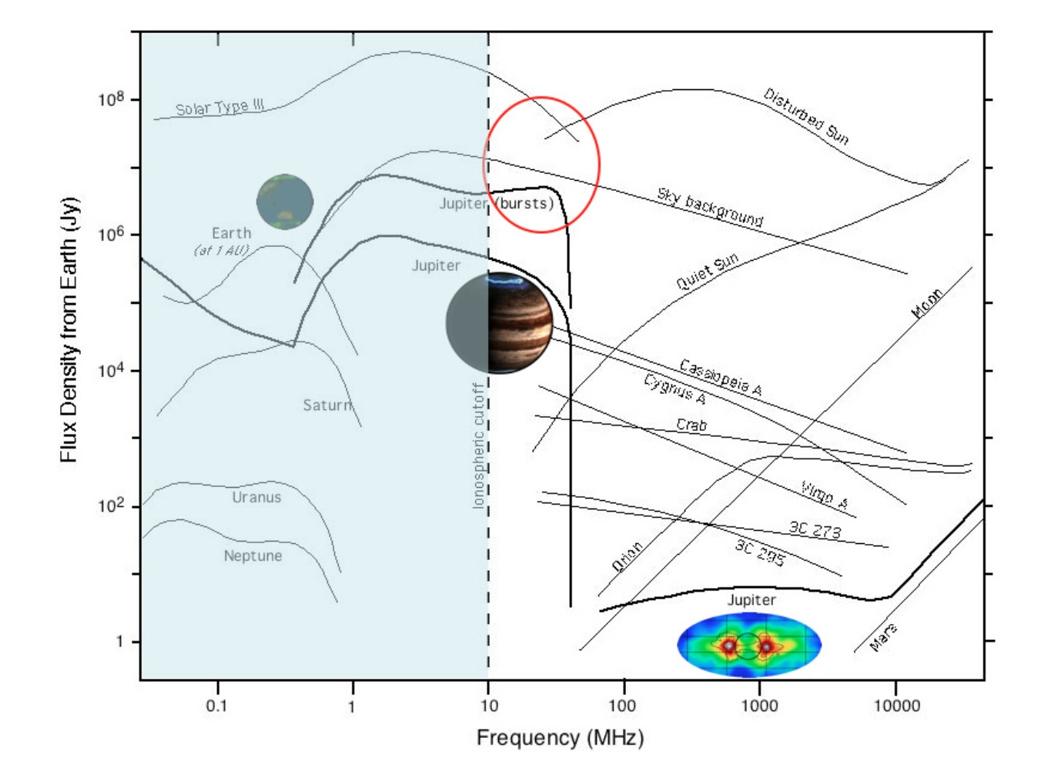
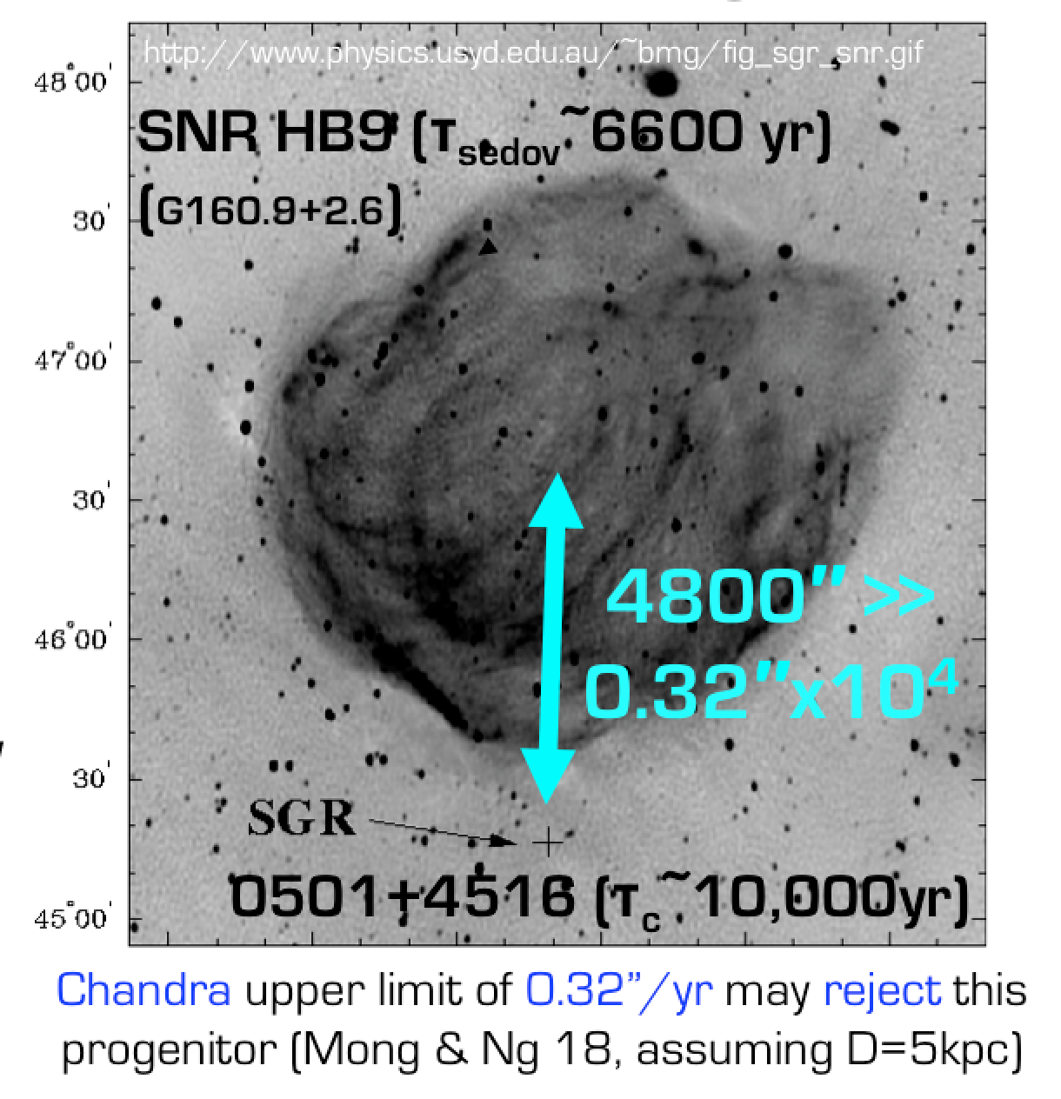
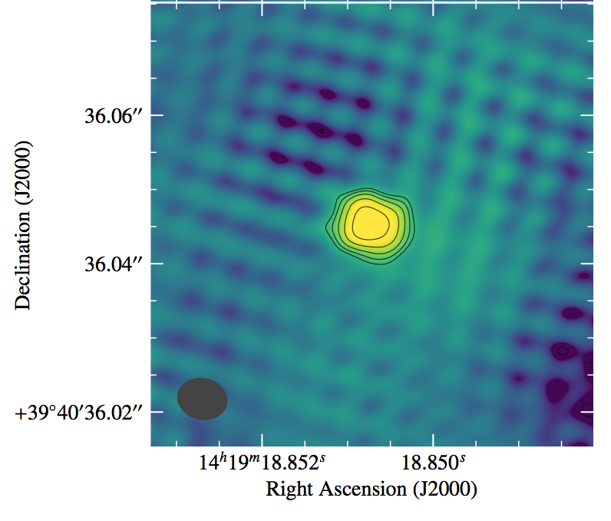
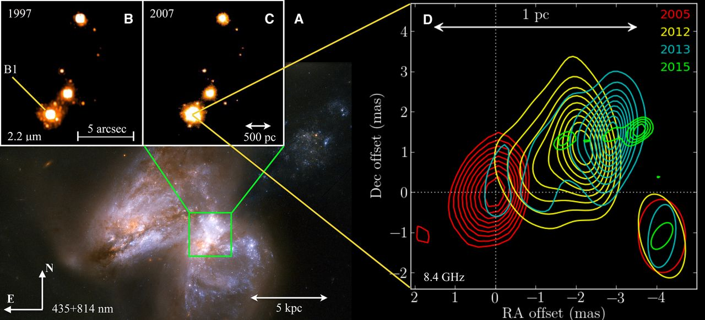
What SKA-VLBI can do for my science?
TRANSIENTS/PULSARS:
Key Science Themes
Marcote et al., 2018
European VLBI Network
(e-EVN)
Marcote et al., 2019
Mattila et al., 2018

Slide 21
What SKA-VLBI can do for my science?
TRANSIENTS/PULSARS:
Key Science Themes
GW-EM
counterparts
Exoplanets
FRBs
Marcote et al., 2018
Magnetars/
pulsars
GRB/
novae/SNe
TDE
and more…
European VLBI Network
(e-EVN)
Marcote et al., 2019
Mattila et al., 2018

Slide 22
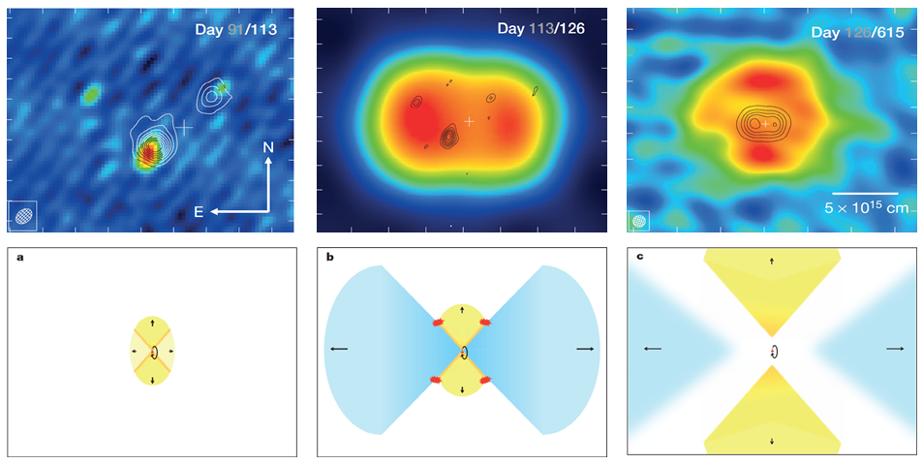
What SKA-VLBI can do for my science?
TRANSIENTS/PULSARS
Faint synchrotron radio transients in the local Universe d ≤ 200Mpc (z ~ 0.05)
Faint collimated ejecta can be resolved within weeks!
proper motions in the ~1 μas regime
GW astronomy: SKA-VLBI sensitivities and excellent calibration needed for resolving mildly relativistic outflows, long-term radio afterglows (BNS mergers, long-GRBs, etc.)
FRBs: SKA-VLBI for progenitor environments and high-z localisations.
Exoplanets: orbital motions will be detectable with SKA-VLBI.
Magnetars: SKA-VLBI reaches the GC and covers a very large galactic volume for proper motion measurements.
e-EVN, JVLA, VLBA, e-Merlin
Chomiuk et al., Nature,
514, 339, 2014
SKA-VLBI to measure very accurately:
Source expansion / apparent jet speed
Proper motions
Parallax (distances)

Slide 23
Thank you!
Enhancing the Square Kilometre Array with VLBI angular resolutions
Cristina García Miró
JIVE

