Slide 1
Outreach & Advocacy
Ilse van Bemmel (JIVE)
Notes:
WP2 is related to outreach and advocacy. These are two tasks in the project plan. Outreach = awareness of general public and peers about JIVE and EVN (visibility, what it is, what it can do) —> one way communication
Advocacy = engaging policy makers and peers to join JIVE (new users, new JIVE members) —> two way communication
In this talk the two terms will be mixed.

Slide 2
Goals of WP2
Visibility of JIVE and EVN
Outreach and advocacy towards:
Peers
Public
Policy makers
Notes:
JIVE has been around for 25 years to support EVN science. It is well positioned to become a globally leading VLBI institute, but there are several wrinkles that we need to flatten out.
cool science results obtained with the EVN do not always reach a global (or even EU) audience
JIVE and the EVN require more visibility to potential new users and JIVE / EVN members
The funding in WP2 allows JIVE to obtain resources (human, funding) to improve the situation

Slide 3
Deliverables
D2.1: brochure
D2.2: booth
D2.3: report
D2.4: final report
Notes:
The deliverables for the WP2 are the following:
Brochure, booth and reports have been delivered on schedule

Slide 4
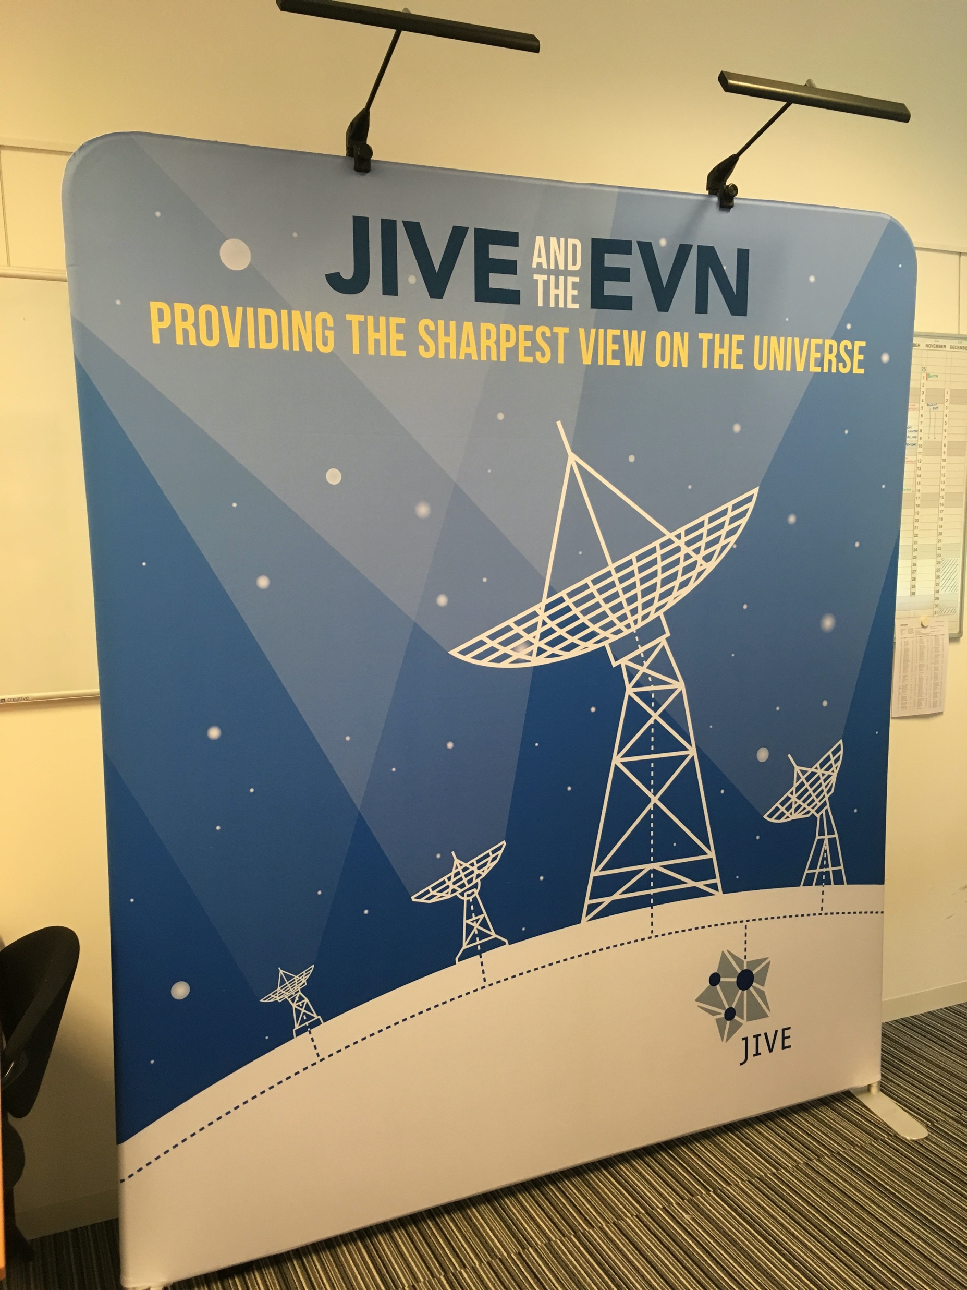
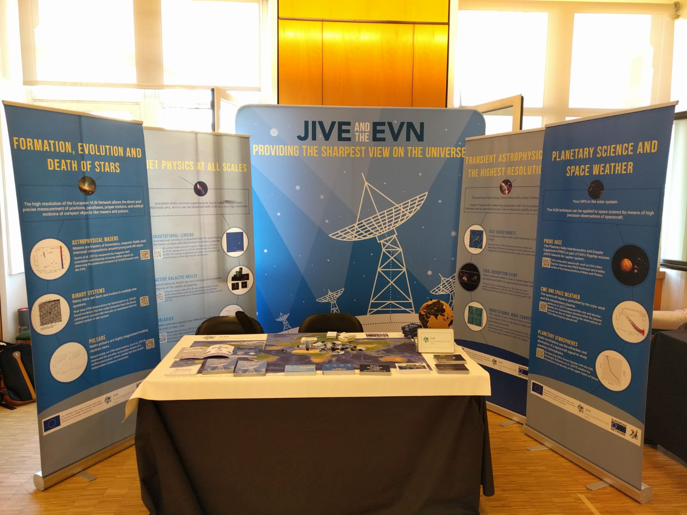

Slide 5
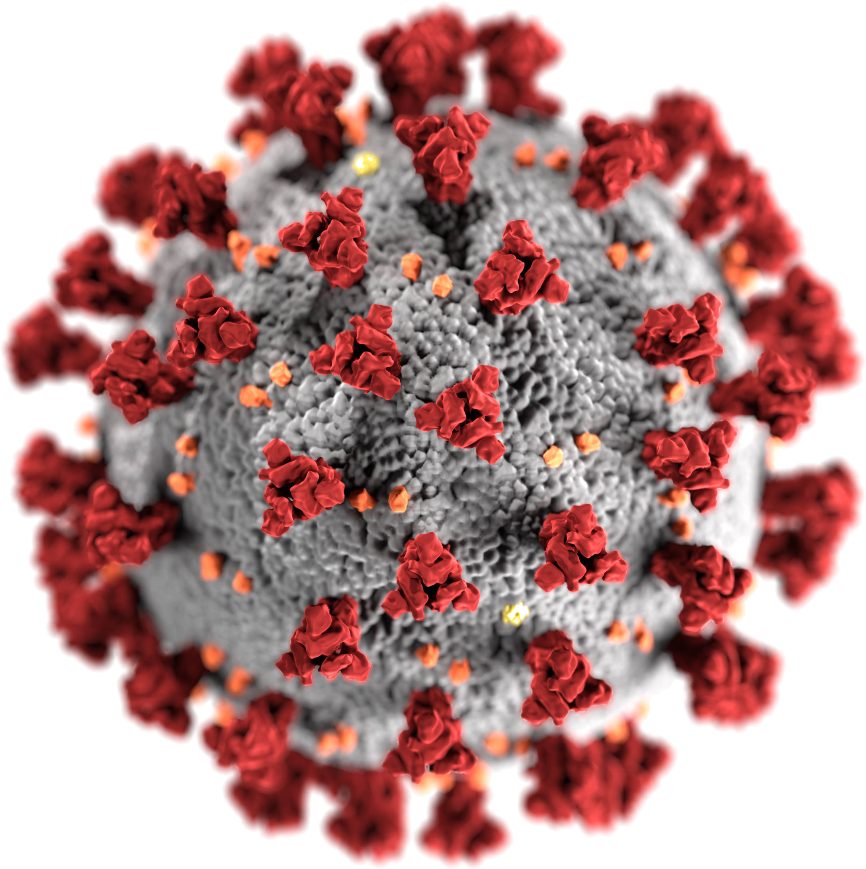
Goals of WP2
Visibility of JIVE and EVN
Outreach and advocacy towards:
Peers
Public
Policy makers
Notes:
COVID-19 forced us to change all the plans, biggest impact was on the CASA-VLBI workshop in November 2020, which started as an in-person meeting
But moving this online and the experience with subsequent online events was a very valuable experience.

Slide 6
Online experience
Diversity
Flexibility
Available long term
Coffee chat
Socializing
Paper materials
Notes:
For outreach and advocacy the online experience was mixed: we reached large numbers of people in regions we usually do not reach, but all our materials developed in JJ were useless
Discussion on hybrid meetings: redevelop materials in digital formats, experiment with online socializing (EVN Gather meeting)
Moving forward: connection to TFOM team
What can we use to our benefit in reaching a wider audience

Slide 7
Impact
EAS2020, EAS2021:
2000+ registered participants
50-100 attending VLBI sessions
CASA-VLBI workshop
200 registrations, very diverse
EVN mini-symposium
120 participants
Notes:
Organisations and impact of online meetings we attended or (partly) organised

Slide 8
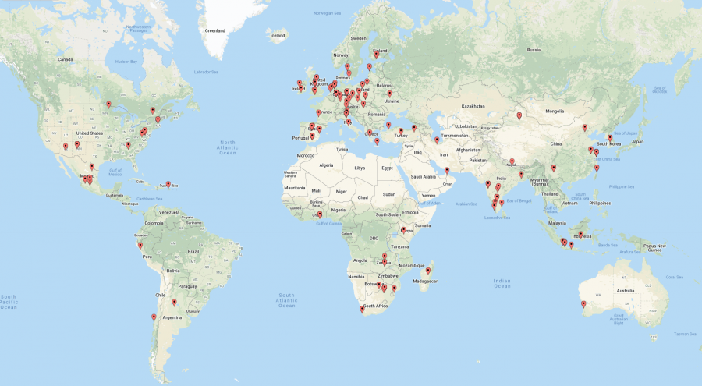
Notes:
Diversity: CASA-VLBI attracted participants from Indonesia, Madagascar, Peru, Turkey
But also from countries that are part of the WP3 efforts: Finland, Poland
Overlap with DARA: several African countries where DARA efforts are also focused

Slide 9
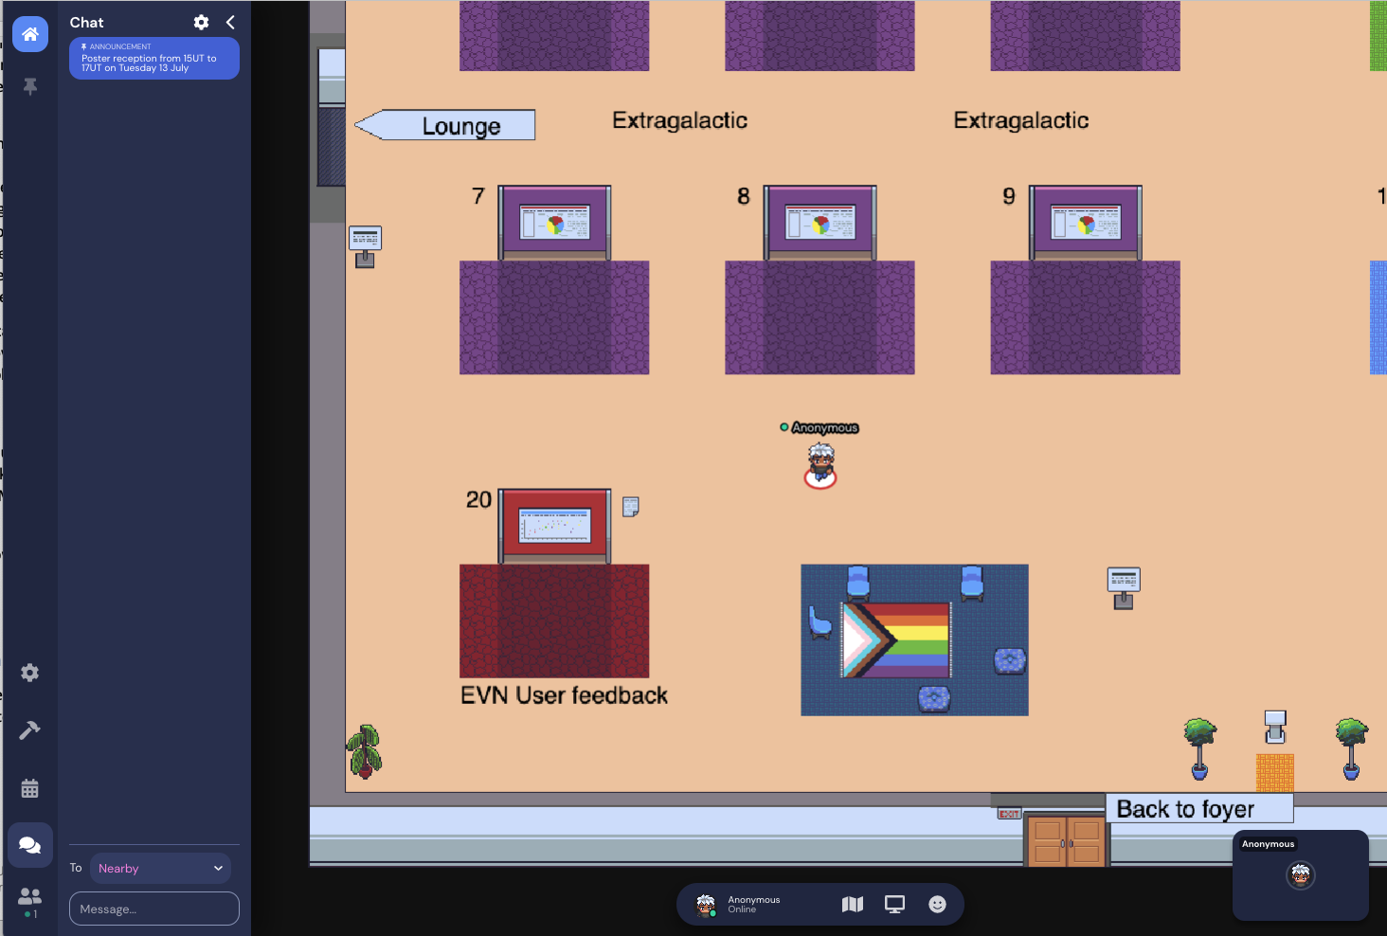
Gather
Notes:
Experimenting with new platforms for scientific social interactions: Gather for the EVN mini-symposium poster room

Slide 10
Ongoing and future work
Cartoon (WP6)
Expand audiences: URSI 2020-2021
EVN outreach network
Format of materials
Outreach is a continuous effort

Slide 11
Thank you!

